Slide 1
REINFORCEMENT LEARNING · CHAPTER 01
CONTENTS
Agent Architectures
PART I
Agents and environments
PART II
From agent function to agent program
PART III
Properties of the environment
PART IV
Performance measure and rationality
PART V
Agent architectures
PART VI
Case study: flocking
From the agent–environment loop to reflex, model-based, goal-based, utility-based and learning agents — and a worked example in which collective behaviour emerges from purely local rules.
Università degli Studi di Genova · DITEN — ELIOS Lab
Lecture notes, Chapter 01 — companion slides

Slide 2
PART I
01 The agent–environment loop
02 Sensors, actuators, percepts, actions
03 One paradigm, three embodiments
04 PEAS: specifying the task
Agents and environments
What an agent is, where its boundary lies, and how a task is specified before any program is written.
KEEP THIS QUESTION IN MIND
Why does the agent concept unify robotics, software and control?

Slide 3
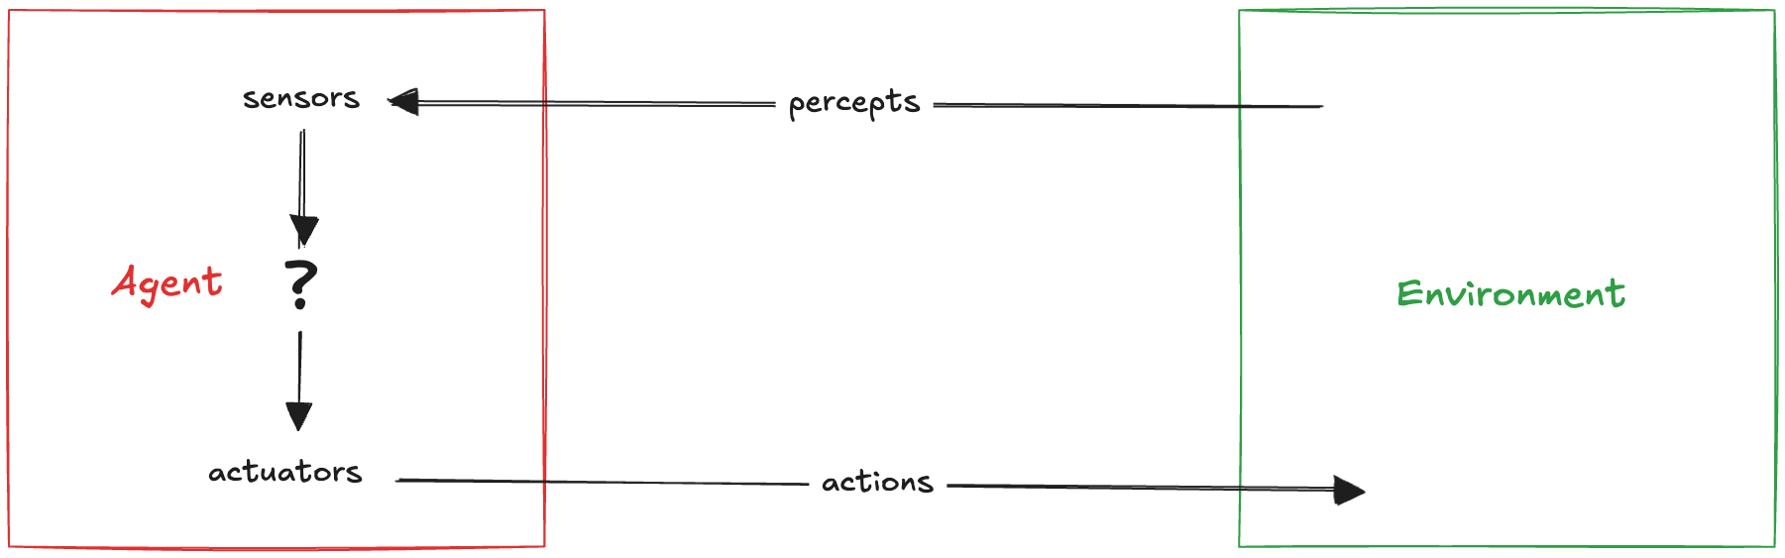
1.1 THE AGENT–ENVIRONMENT LOOP
An agent is defined by the loop it closes with its environment
An agent is an entity that perceives an environment through sensors and acts upon it through actuators, in order to achieve a task or objective.
WHERE THE BOUNDARY IS DRAWN
In principle the environment could be the entire universe. In practice it is defined as the part that influences the agent’s percepts and is altered by its actions.
THE TWO QUESTIONS OF THIS CHAPTER
What should the agent do with the percept it has just received?
How is that mapping represented, so that a physical machine can compute it?
ONE PARADIGM, THREE EMBODIMENTS
WHY THIS ABSTRACTION IS USEFUL
Human agent
Robotic agent
Software agent
The same vocabulary — percept, action, state, performance — describes a thermostat, a chess program, a warehouse robot and a trading system.
Reinforcement learning is built directly on this loop: percepts become states, actions stay actions, and the performance measure becomes a reward.
sensors eyes, ears, skin
actuators hands, legs, voice
sensors cameras, range finders
actuators motors, grippers
sensors files, network, user input
actuators writes files, sends data, displays
The agent concept is a unifying paradigm: the three descriptions above differ only in hardware, never in structure.
Reinforcement Learning · Chapter 01 — Agent Architectures · Part I — Agents and environments
3

Slide 4
1.2 PEAS
Before designing an agent, specify the task it is meant to solve
Once an agent has been identified, its task is described by four elements: what counts as success, where it operates, how it can act, and what it can perceive. These are grouped under the acronym PEAS. The bottom line of each card applies PEAS to the vacuum world used throughout this chapter.
WORKED EXAMPLE
Part-picking robot
P
Percentage of parts placed in the correct bins
P
E
A
S
E
Conveyor belt with parts; bins
Performance measure
Environment
Actuators
Sensors
A
Jointed arm and hand
The externally defined criterion of success. Not what the agent does — what the world should look like.
Everything the agent acts in and perceives from, including other agents.
The set of actions physically available to the agent.
The channel through which percepts arrive; it bounds what the agent can ever know.
S
Camera, tactile and joint-angle sensors
The same task admits many programs — but only one PEAS description. Fixing PEAS first is what makes two designs comparable.
vacuum world
sustained cleanliness of both squares
vacuum world
two squares A and B; dirt may reappear
vacuum world
left, right, suck, do nothing
vacuum world
location sensor + dirt detector
A WARNING THAT RETURNS IN PART IV
The performance measure is written by the designer, not by the agent. Everything that follows — goals, utilities, rewards — is an attempt to make the agent pursue it. If it is specified badly, a perfectly rational agent will pursue the wrong thing, perfectly.
Reinforcement Learning · Chapter 01 — Agent Architectures · Part I — Agents and environments
4

Slide 5
1.3 PEAS IN PRACTICE
Five agent types, five task specifications
Read each row left to right: the measure fixes what success means, and the last two columns fix what the agent can physically do and know. Notice how different the sensor and actuator channels are, while the structure of the description never changes.
Agent type
Performance measure
Environment
Actuators
Sensors
Medical diagnosis system
Healthy patient, reduced costs
Patient, hospital, staff
Questions, tests, diagnoses, treatments
Touchscreen / voice entry of symptoms and findings
Satellite image analysis
Correct categorization of objects, terrain
Orbiting satellite, downlink, weather
Display of scene categorization
High-resolution digital camera
Part-picking robot
Percentage of parts in correct bins
Conveyor belt with parts; bins
Jointed arm and hand
Camera, tactile and joint-angle sensors
Refinery controller
Purity, yield, safety
Refinery, raw materials, operators
Valves, pumps, heaters, stirrers, displays
Temperature, pressure, flow, chemical sensors
Interactive English tutor
Student’s score on test
Set of students, testing agency
Exercises, feedback, speech
Keyboard entry, voice
THREE THINGS TO NOTICE
Measures are usually proxies
Sensors bound what can be known
Actuators bound what can be achieved
A test score is not learning, purity is not profitability, and “healthy patient” hides a trade-off against cost.
The tutor never observes understanding, only keystrokes and speech. No program can recover information the sensor channel never carried.
The diagnosis system cannot treat, only display. The set of reachable world-states is fixed before a single line of the program is written.
Reinforcement Learning · Chapter 01 — Agent Architectures · Part I — Agents and environments
5

Slide 6
PART II
01 Agent function and agent program
02 The vacuum world, tabulated
03 Counting the percept sequences
04 Why lookup tables cannot exist
From agent function to agent program
The behaviour of an agent is a mathematical object; the program is an implementation of it that has to fit in a machine.
KEEP THIS QUESTION IN MIND
If the table already solves the problem, why is AI hard?

Slide 7
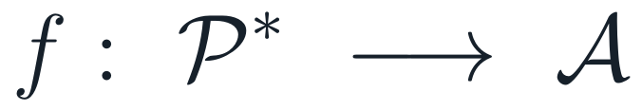
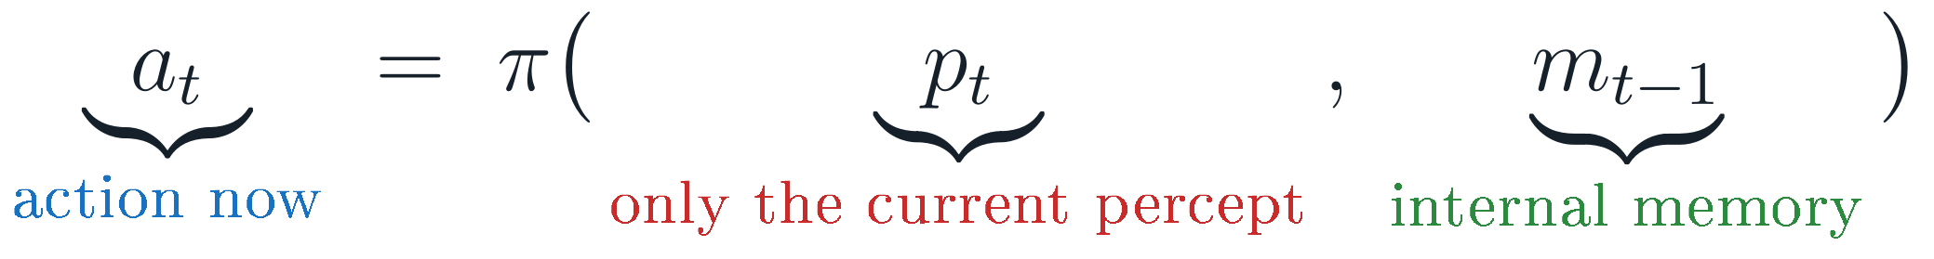
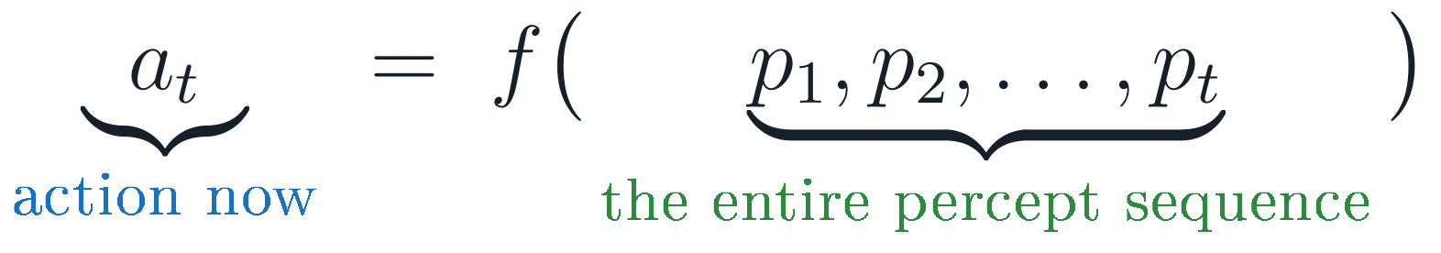
2.1 TWO DIFFERENT OBJECTS
Behaviour is a function; a program is only its implementation
At any moment an agent’s action is determined by its built-in knowledge and by the entire sequence of percepts observed so far. It cannot depend on anything outside its perceptual experience. That dependency is what the agent function makes precise.
AGENT FUNCTION
An abstract mathematical mapping
AGENT PROGRAM
A concrete implementation on a machine
Defined over the set of all percept sequences, it prescribes one action for every history the agent could ever experience. It specifies behaviour, and says nothing about how the mapping is computed.
The environment delivers one percept at a time, so the program receives only the current percept. If the decision must depend on the past, the program has to store that past itself, in an internal memory m — the single observation that drives every architecture in Part V.
Keeping the two apart matters: the function can be infinite, the program must be finite. The whole of Part II is an argument that writing the function down explicitly is never an option, and therefore that the interesting question is how to compute it compactly.
Reinforcement Learning · Chapter 01 — Agent Architectures · Part II — Agent function and agent program
7

Slide 8
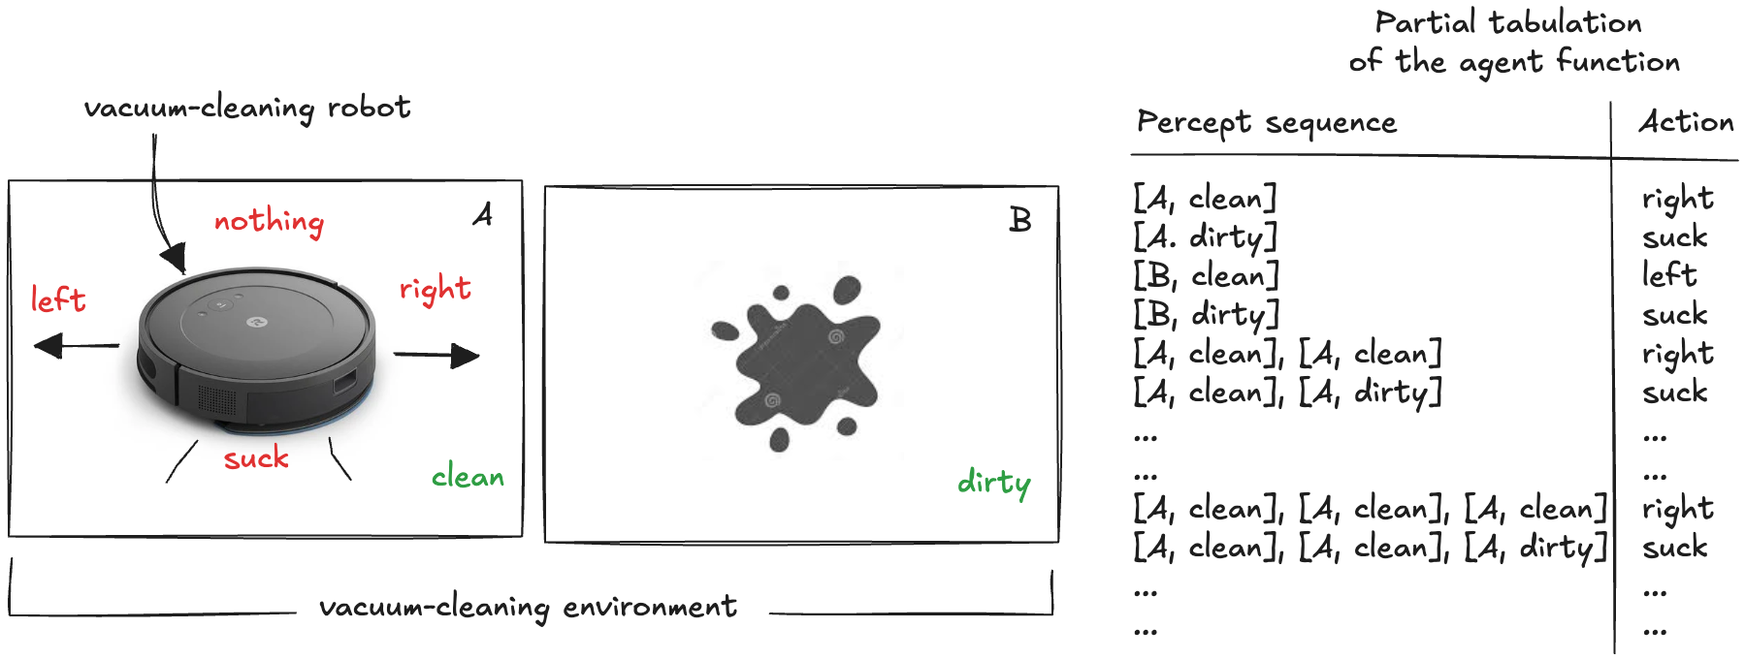
2.2 THE VACUUM WORLD
A world small enough that the agent function can actually be written down
Two squares, A and B. Each is either clean or dirty. The agent perceives its own location and the state of that square, and chooses among four actions: move left, move right, suck, do nothing.
The percept
A percept is a pair (location, status). A percept sequence is the whole ordered list of pairs seen since the agent was switched on.
The tabulation
Each row of the table on the right is one percept sequence; the entry beside it is the action the designer wants. Filling in every row defines the agent function completely.
The catch
The table is unbounded: sequences of length 1, then 2, then 3 … The three dots are doing an enormous amount of work. The next two slides count exactly how much.
Reinforcement Learning · Chapter 01 — Agent Architectures · Part II — Agent function and agent program
8

Slide 9
2.3 THE TABLE-DRIVEN AGENT
The program must store the history that the function is defined on
The most direct implementation keeps every percept in a list and uses the list as a key into a table of actions. It represents the agent function explicitly — one entry for every possible percept sequence.
WHY THE LIST IS THERE
The agent function is defined on p₁ … p_t, but the sensors deliver only p_t. The gap between the two is bridged by memory — here, the crudest possible memory: keep everything.
THE AGENT PROGRAM
WHAT THIS BUYS, AND WHAT IT COSTS
def TableDrivenAgent(table):
# the percepts seen so far
percepts = []
def program(percept):
percepts.append(percept) # remember
action = table.get(tuple(percepts)) # look up
return action
return program
It is correct by construction: if the table is filled in properly, the agent does exactly what we want.
It is completely general: any agent function whatsoever can be represented this way.
It requires the designer to specify the right action for every possible history — before the agent is ever switched on.
THE REAL OBJECTION
To build a rational agent this way, someone must anticipate every situation in advance. That is not an engineering difficulty; it is an impossibility, and the next three slides quantify it.
All agent programs share this shape: a percept comes in from the sensors, an action goes out to the actuators. Only the middle changes.
THE THREE MOVING PARTS OF ANY AGENT PROGRAM
What it receives
One percept, delivered by the sensors at this time step. Never the history, never the state of the world.
What it keeps
Whatever it chooses to store. Here the full list of percepts; in §5.2 nothing; in §5.6 a compact state.
What it returns
One action, handed to the actuators. The environment does the rest, and the next percept arrives.
Reinforcement Learning · Chapter 01 — Agent Architectures · Part II — Agent function and agent program
9

Slide 10
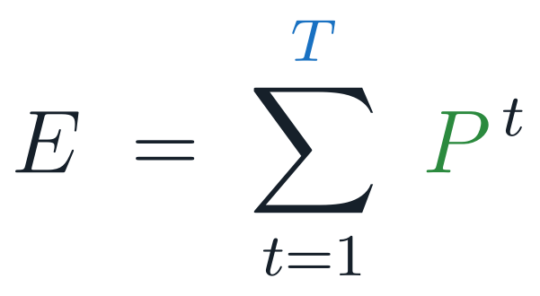
2.4 WHAT THE TABLE CANNOT DO
A lookup fails on any history the designer did not foresee
Here is a deliberately partial table, listing only some sequences of length up to three:
WHY THE LAST ACTION IS None
After three steps the agent has observed the sequence
PARTIAL TABLE AND A THREE-STEP RUN
(("A","clean"), ("A","dirty"), ("B","clean"))
table = {
(("A", "clean"),): "right",
(("A", "dirty"),): "suck",
(("B", "clean"),): "left",
(("B", "dirty"),): "suck",
(("A", "clean"), ("A", "clean")): "right",
(("A", "clean"), ("A", "dirty")): "suck",
...
}
agent = TableDrivenAgent(table)
print(agent(("A", "clean"))) # right
print(agent(("A", "dirty"))) # suck
print(agent(("B", "clean"))) # None
which is simply not a key in the table. The lookup returns nothing, and no action is defined. A table-driven agent can only act in situations that were enumerated in advance.
THE GENERAL STATEMENT
With P possible percepts at each step and a lifetime of T percepts, completeness requires an entry for every sequence of length 1, 2, … up to T.
The size of a complete lookup table.
Reinforcement Learning · Chapter 01 — Agent Architectures · Part II — Agent function and agent program
10

Slide 11
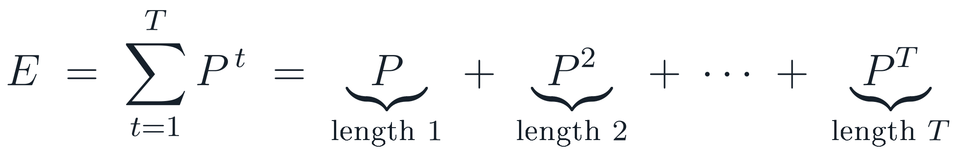
2.5 COUNTING THE TABLE — STEP 1
The number of entries is a geometric series in the number of percepts
The table needs one row for every percept sequence the agent could ever observe. Group the sequences by their length: there are P sequences of length one, P² of length two, and in general P^t of length t.
P — how much can be perceived at one step
The number of distinct percepts the sensors can produce. For the vacuum agent P = 4: two locations × two dirt states. For a camera it is astronomically larger.
T — how long the agent lives
The lifetime measured in percepts, not in seconds. A camera at 30 frames per second produces 108 000 percepts in a single hour of operation.
Why the sum, and not just P^T
The agent must act at every step, not only at the last one. Its very first decision is taken after one percept, so sequences of every length up to T need an entry.
The sum is exact; nothing has been approximated yet. What follows is only the observation that, for any sensor worth having, one of these terms is larger than all the others put together.
Reinforcement Learning · Chapter 01 — Agent Architectures · Part II — Agent function and agent program
11

Slide 12
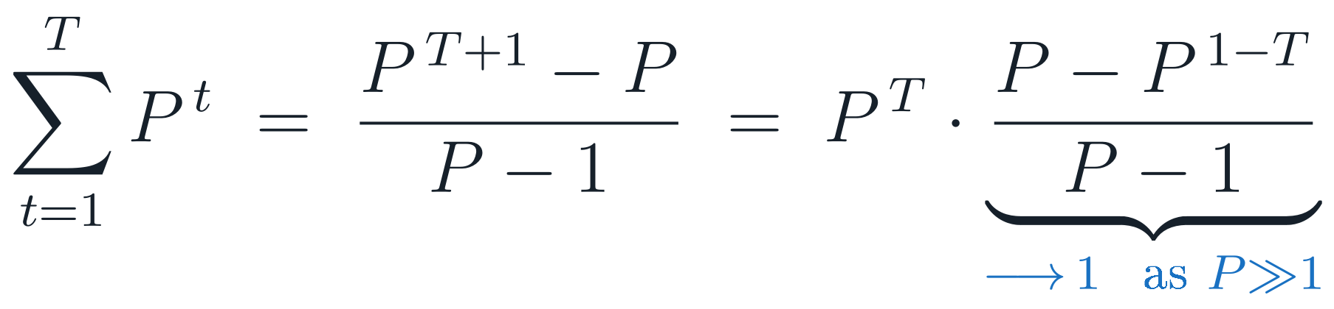
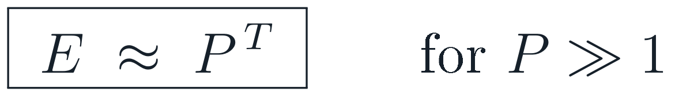
2.6 COUNTING THE TABLE — STEP 2
For any realistic sensor, the last term swallows the whole sum
The sum is geometric, so it has a closed form. Factoring out the largest term shows what happens when P is large.
READ THE RESULT CAREFULLY
The approximation is not a convenience — it is the point. Table size grows exponentially in the lifetime of the agent, with the number of distinct percepts as the base. Doubling the resolution of a sensor does not double the table; it squares it.
CLOSE THE SERIES, THEN FACTOR OUT P^T
A SMALL SANITY CHECK
Vacuum world: P = 4 percepts. A lifetime of only T = 20 steps already needs about 4²⁰ ≈ 10¹² entries — a thousand billion rows, for a world with two squares.
Every realistic sensor has P ≫ 1, so the bracketed correction factor tends to 1 and the final term dominates everything that came before it. The sum collapses to a single power:
And note what the table still does not give us: generalisation. Two nearly identical histories occupy two unrelated rows. Nothing learned about one transfers to the other.
Read the exponent, not the base. P is fixed once the sensors are chosen. T is the agent’s lifetime, and it grows every second the agent is switched on — so a complete table is not merely large, it grows without bound while the agent runs.
Reinforcement Learning · Chapter 01 — Agent Architectures · Part II — Agent function and agent program
12

Slide 13
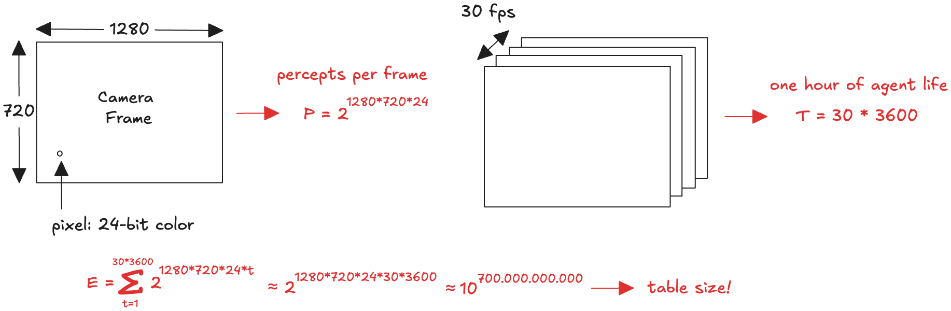
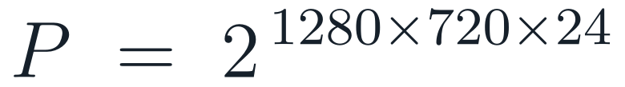
2.7 A SINGLE CAMERA SETTLES THE QUESTION
One hour of video, and the table no longer fits in the universe
Take an automated driving agent whose only sensor is one camera: 1280 × 720 pixels, 24-bit colour, 30 frames per second. Count its percepts.
PERCEPTS PER FRAME
PERCEPTS IN ONE HOUR
RESULTING TABLE SIZE
That exponent has twelve digits. There is no sense in which such a table is “large but difficult”: it is physically impossible — to store, to write, and to learn. And the camera in this example is a modest one.
Reinforcement Learning · Chapter 01 — Agent Architectures · Part II — Agent function and agent program
13

Slide 14
2.8 THE CONCLUSION OF PART II
The table does exactly what we want, and cannot exist
Chess is a far smaller and far more structured domain than driving, and the estimate for its table is still around 10¹⁵⁰ entries. For comparison, the observable universe contains fewer than 10⁸⁰ atoms.
WHAT IS RIGHT ABOUT IT
The table-driven agent is a correct solution.
Assuming its entries are filled in properly, it implements the desired agent function exactly. Nothing is approximated, nothing is lost. As a specification of behaviour it is perfect.
WHAT IS WRONG WITH IT
No physical agent can store, write or learn it.
It cannot be stored — no medium is large enough. It cannot be written — no designer has the time. It cannot be learned — no lifetime of experience covers a fraction of the rows.
The task of AI is therefore not to specify the agent function, but to design agent programs that produce it compactly.
For the vacuum world, one line already replaces the entire table: “if the current square is dirty, clean it; otherwise move to the other square.” Everything in Part V is a more powerful version of that same move.
Reinforcement Learning · Chapter 01 — Agent Architectures · Part II — Agent function and agent program
14

Slide 15
PART III
01 Observability · agents · determinism
02 One-shot vs sequential
03 Dynamics · continuity · knowledge
04 Ten environments compared
Properties of the environment
The environment is the problem; the agent is the solution. Seven dimensions decide how hard that problem is.
KEEP THIS QUESTION IN MIND
Which property forces the agent to remember, and which forces it to plan?

Slide 16
3.1 WHY CLASSIFY ENVIRONMENTS
The environment is the problem; its properties decide the architecture
Rather than analysing every new task from scratch, characterise the environment along a small set of dimensions. Taken together they determine how hard the decision problem is — and, as Part V shows, which machinery the agent program actually needs.
Observability
fully / partially
Do the sensors reveal everything relevant to the decision?
Agents
single / multi
Does anything else in the world optimise its own measure?
Determinism
deterministic / stochastic / non-det.
Is the next state fixed by the current state and action?
Decision structure
one-shot / sequential
Does the current action change what happens later?
Partial observability forces an internal state.
Multi-agent forces reasoning about others.
Uncertainty forces expectations or worst cases.
Sequentiality forces looking ahead — this is RL.
Dynamics
static / semi-dynamic / dynamic
Can the world change while the agent is thinking?
Continuity
discrete / continuous
Are states, time, percepts and actions enumerable?
Knowledge of the rules
known / unknown
Does the agent know the outcomes of its own actions?
THE HARDEST CASE
Partially observable, multi-agent, stochastic, sequential, dynamic and continuous.
Autonomous driving is difficult in every one of these senses at once — which is exactly why it resists any single technique.
Dynamism puts deliberation under a deadline.
Continuity forces function approximation.
Unknown dynamics force learning.
Reinforcement Learning · Chapter 01 — Agent Architectures · Part III — Properties of the environment
16

Slide 17
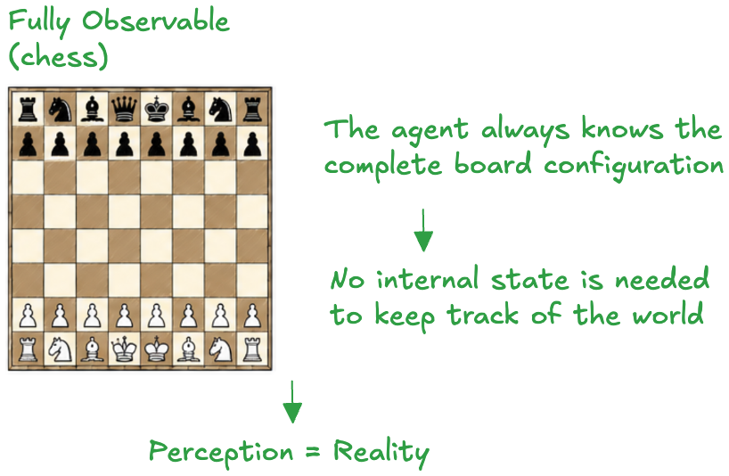
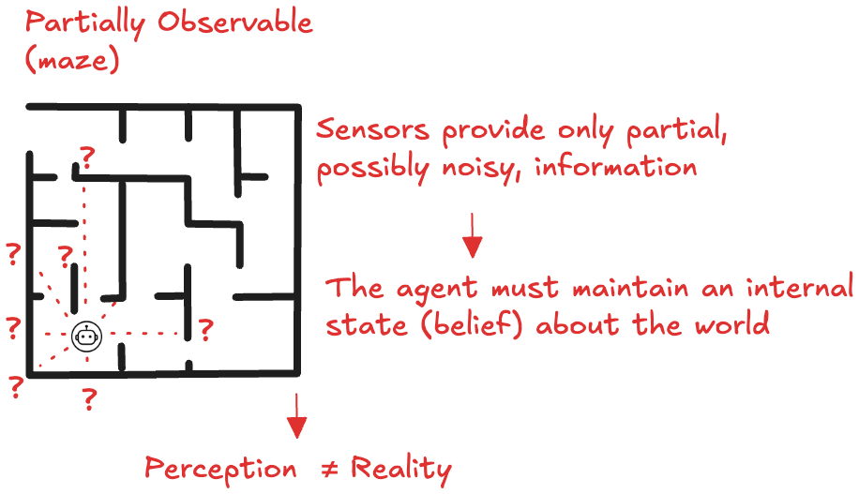
3.2 OBSERVABILITY
When perception is not reality, the agent must remember
An environment is fully observable if the sensors provide, at all times, everything relevant to choosing an action. Otherwise it is partially observable — because sensors are noisy, limited in range, or simply cannot see through walls.
FULLY OBSERVABLE
No internal state is needed
Perception coincides with reality. The current percept is a sufficient summary of the world, so the agent can decide without remembering anything.
PARTIALLY OBSERVABLE
The agent maintains a belief
The percept is a partial, possibly noisy view. The agent must carry an internal estimate of what it cannot currently see, updated as new percepts arrive.
CONSEQUENCE FOR DESIGN
This dimension alone separates §5.2 from §5.3
Simple reflex agents are adequate only when the environment is fully observable. Everything else needs the model-based architecture.
Reinforcement Learning · Chapter 01 — Agent Architectures · Part III — Properties of the environment
17

Slide 18
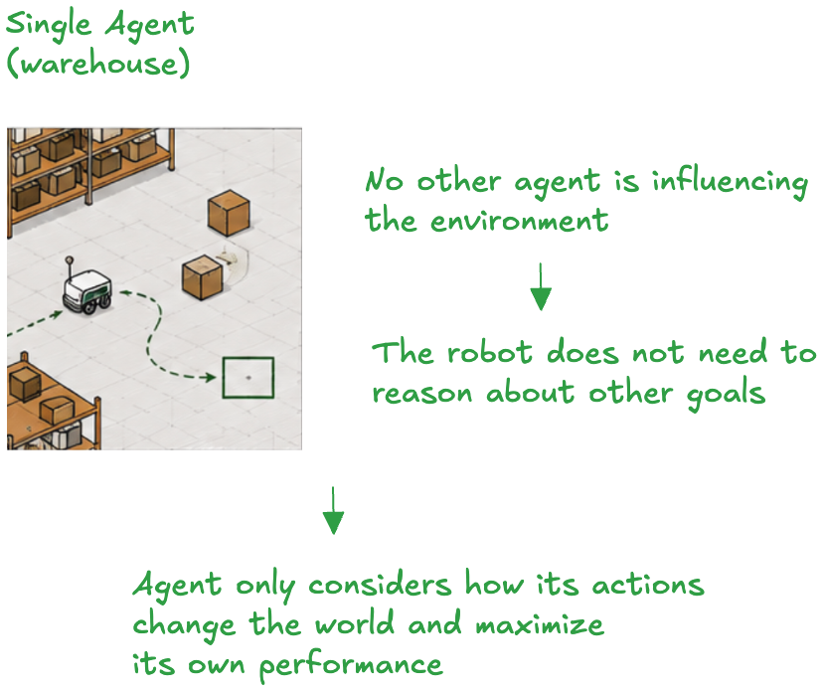
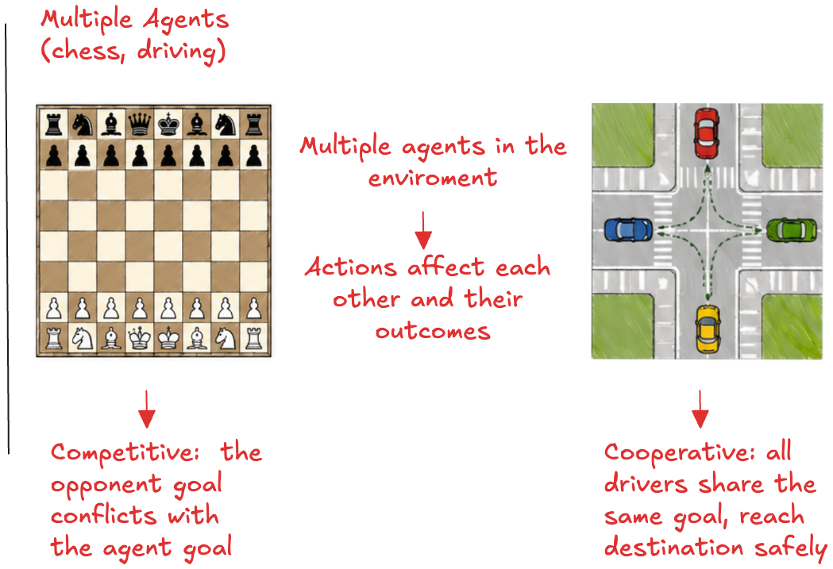
3.3 NUMBER OF AGENTS
Another agent is not an obstacle: it optimises against you
An environment is single-agent if only one agent influences it, and multi-agent if several agents’ actions affect one another’s outcomes. Multi-agent settings split further into competitive and cooperative.
SINGLE AGENT
Only the agent’s own actions change the world
The warehouse robot plans against physics alone. Nothing in the environment is trying to do anything about it.
COMPETITIVE
The opponent’s gain is the agent’s loss
In chess the opponent selects moves precisely to reduce the agent’s performance. Randomisation can itself become rational, because it is unpredictable.
COOPERATIVE
Shared measure, so communication pays
Drivers at a junction all want to arrive safely. Signalling intent — indicators, lane discipline — is a rational action rather than wasted effort.
Reinforcement Learning · Chapter 01 — Agent Architectures · Part III — Properties of the environment
18

Slide 19
3.4 A MODELLING DECISION, NOT A FACT
Agent or obstacle? The boundary is chosen, not discovered
The boundary is not given by the world; it is chosen by the designer. The same physical object can be modelled either way, and the choice changes the program that has to be written.
THE GENERAL POINT
Every dimension on the previous slide is a property of the model the designer builds, not a property the world hands over. Two engineers can legitimately classify the same task differently — and will then write different programs.
THE SAME OBJECT, TWO MODELS
As part of the environment
The other vehicle is a physical object governed by the laws of motion. Predict its trajectory by extrapolation; treat deviations as noise.
As an independent agent
The other vehicle is a decision-maker with its own destination, its own performance measure, and a view of us. Predict what it will choose, not where it will drift.
FURTHER EXAMPLES
A pedestrian crossing at a signal: an obstacle. Crossing against one: an agent, because their decision responds to ours.
The weather: stochastic environment. It has no measure to optimise and does not react to us.
A market: stochastic for a small trader, multi-agent for a large one — the same world, with the difference being whether our actions move it.
Cheaper. Adequate while the other vehicle behaves predictably — and wrong exactly when it does not.
More expensive, and necessary whenever its choices depend on ours — at a merge, a junction, a negotiation.
The criterion
Treat an entity as an agent when its behaviour is best described as optimising its own performance measure, whose value depends on our actions. If that dependency is absent, it is part of the environment.
Reinforcement Learning · Chapter 01 — Agent Architectures · Part III — Properties of the environment
19

Slide 20
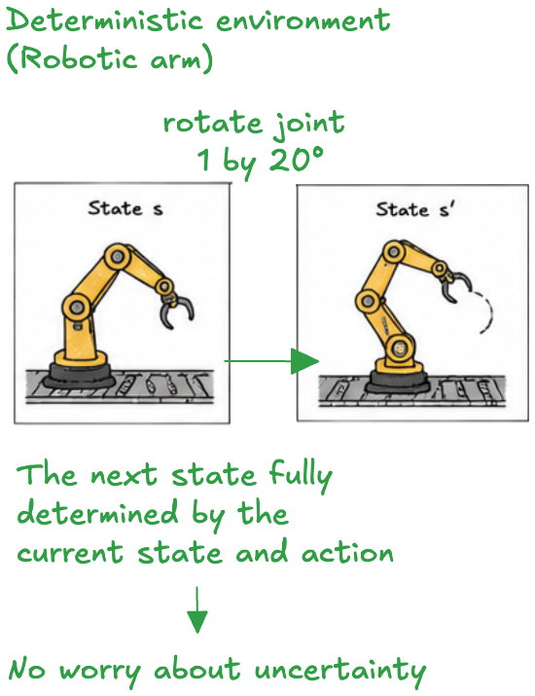
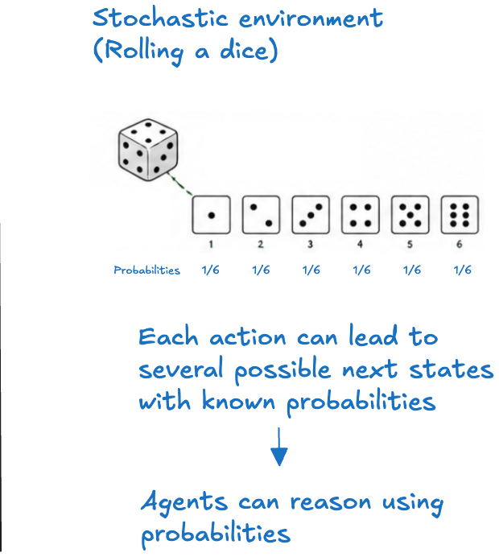
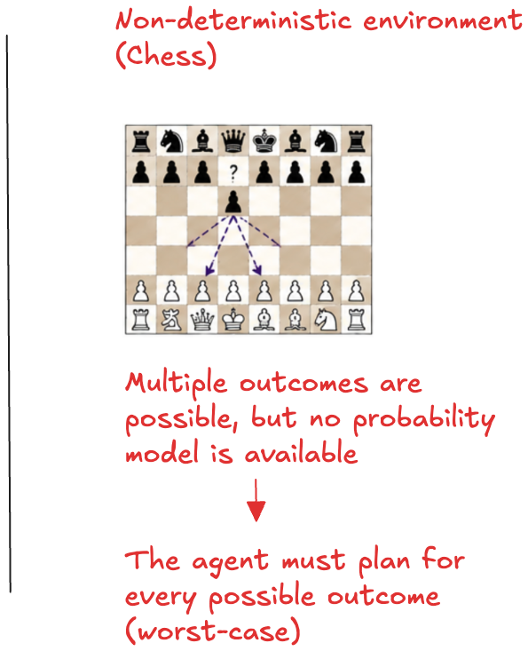
3.5 DETERMINISM
Three different things are meant by “the outcome is uncertain”
An environment is deterministic if the next state is fully determined by the current state and the agent’s action. If it is not, it matters a great deal whether a probability model over the outcomes is available.
DETERMINISTIC
No uncertainty to reason about
State and action fix the successor; the agent plans by composing actions.
STOCHASTIC
Outcomes carry known probabilities
Several successors, with known or estimated probabilities. The agent reasons with expectations — the setting of Chapter 02.
NON-DETERMINISTIC (STRICT)
Possible outcomes, no distribution
Several successors, no probability model. The agent must be prepared for each of them regardless of likelihood: worst-case reasoning.
IN PRACTICE
Real environments are modelled as stochastic
Tracking every relevant factor is impossible, and strict worst-case planning would be paralysingly conservative — so probabilities are estimated and expectations are used.
Reinforcement Learning · Chapter 01 — Agent Architectures · Part III — Properties of the environment
20

Slide 21
3.6 A CASE WORTH LOOKING AT CLOSELY
Chess has deterministic dynamics and a non-deterministic opponent
It is tempting to call chess “non-deterministic”, but the non-determinism does not live in the environment at all. It is a property of how we choose to model the adversary.
The rules of chess
Given a position and a chosen move, the resulting position is fixed. There is no randomness anywhere in the physics of the game.
Deterministic
The opponent’s choice
What the opponent will play is not predictable, and no probability distribution over their strategy is assumed. Every legal reply must be considered.
Non-deterministic
Consequence for the algorithm
Adversarial games are solved with worst-case reasoning — minimax in §5.11 — and not with the expected-value reasoning used for genuinely stochastic environments.
Worst case, not average
The non-determinism belongs to the model of the adversary, not to the environment. Confusing the two leads to using the wrong algorithm: averaging over an opponent who is actively choosing the worst reply is not caution, it is wishful thinking.
Reinforcement Learning · Chapter 01 — Agent Architectures · Part III — Properties of the environment
21

Slide 22
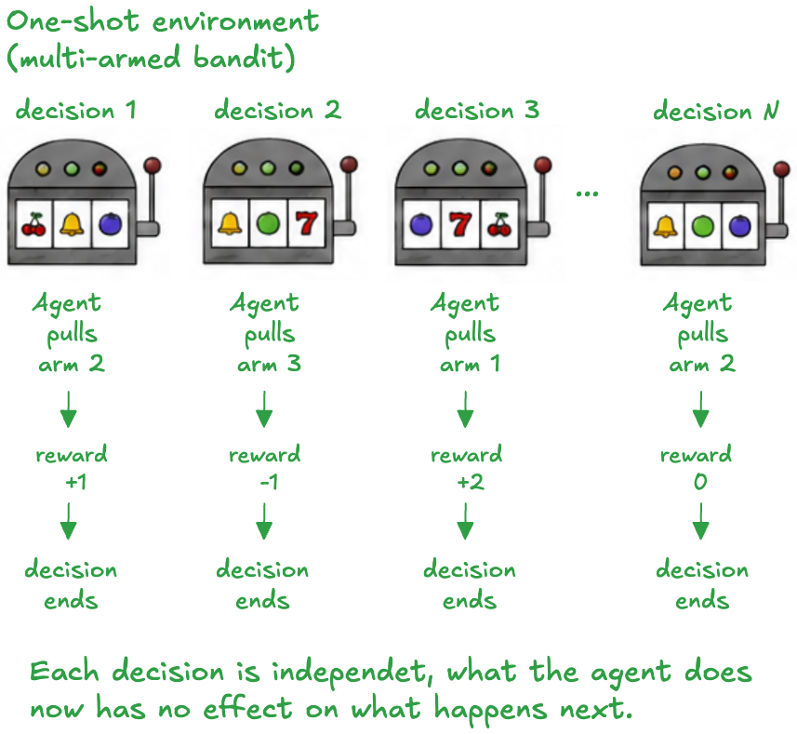
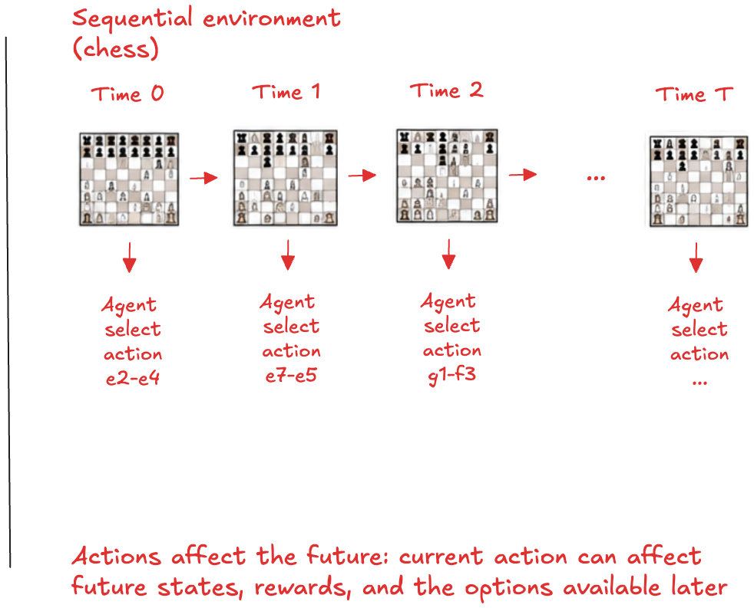
3.7 DECISION STRUCTURE
Sequentiality is the property that makes reinforcement learning necessary
An environment is one-shot if the agent’s experience decomposes into independent decisions, and sequential if the current action can affect every decision that follows.
ONE-SHOT
Each decision stands alone
In the multi-armed bandit, the reward from a pull depends only on the arm chosen. Pulling one arm changes nothing about what the others will pay next time.
SEQUENTIAL
The present constrains the future
A move in chess restricts the moves available later. Acting well requires reasoning about consequences over time, not about this step in isolation.
WHY IT MATTERS HERE
This is the subject of the course
Reinforcement learning is the study of sequential decision-making. Bandits (Chapter 04) are the one-shot special case, used to isolate exploration from everything else.
Reinforcement Learning · Chapter 01 — Agent Architectures · Part III — Properties of the environment
22

Slide 23
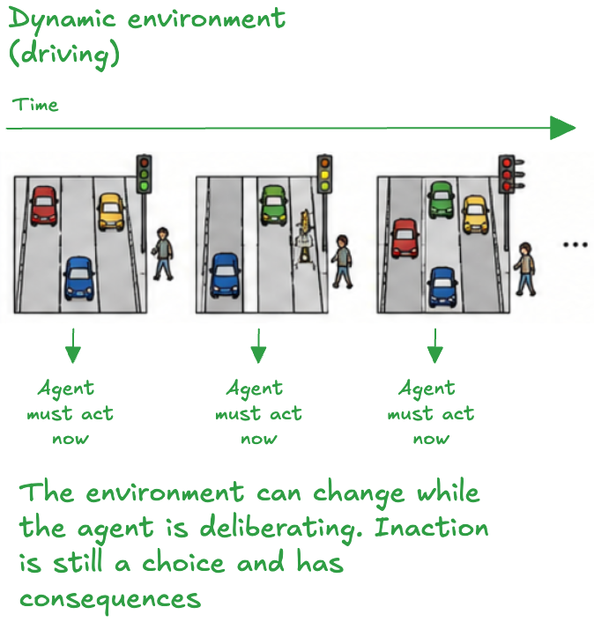
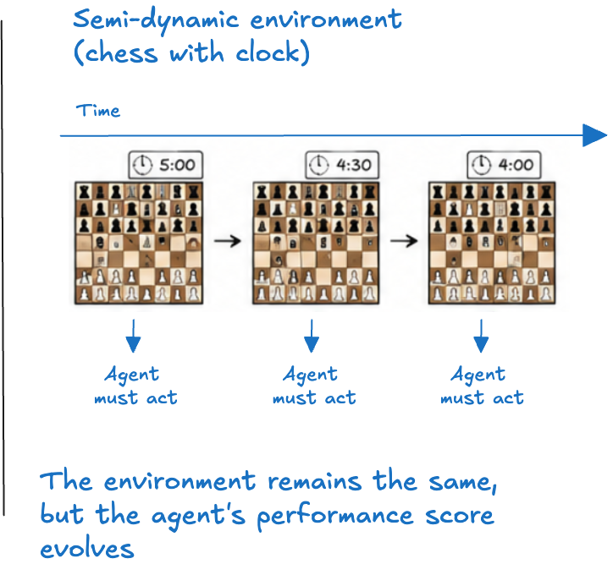
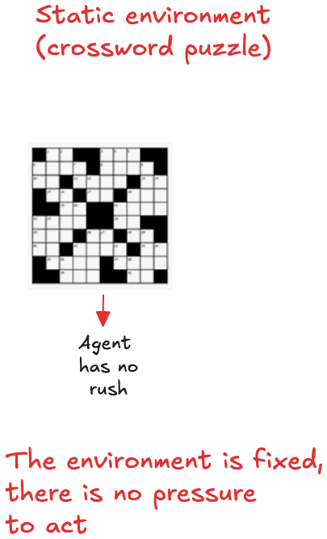
3.8 DYNAMICS
If the world moves while the agent thinks, deliberation has a deadline
An environment is dynamic if it can change while the agent is deliberating, and static if it cannot. A third case is worth naming: the world is unchanged, but the agent’s score is not.
DYNAMIC
Inaction is itself a choice
While the driving agent deliberates, the world moves on. Failing to decide is equivalent to choosing to do nothing, and it has consequences.
SEMI-DYNAMIC
The world waits; the clock does not
In chess with a clock the position is unchanged while the agent thinks, but the performance measure degrades with every second spent.
STATIC
No pressure to act at all
A crossword puzzle waits indefinitely. The agent need not monitor the world or worry about time while choosing.
Reinforcement Learning · Chapter 01 — Agent Architectures · Part III — Properties of the environment
23

Slide 24
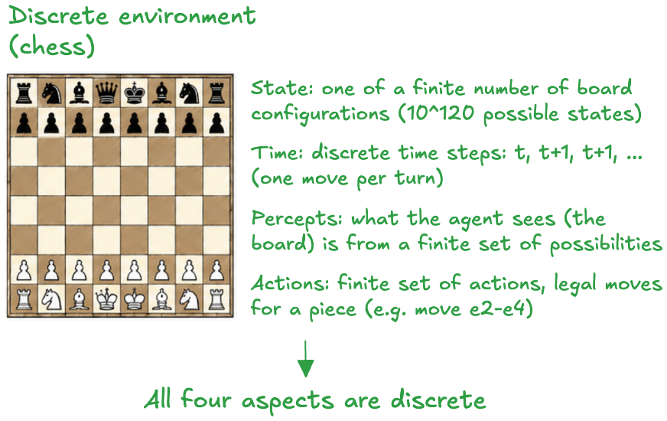
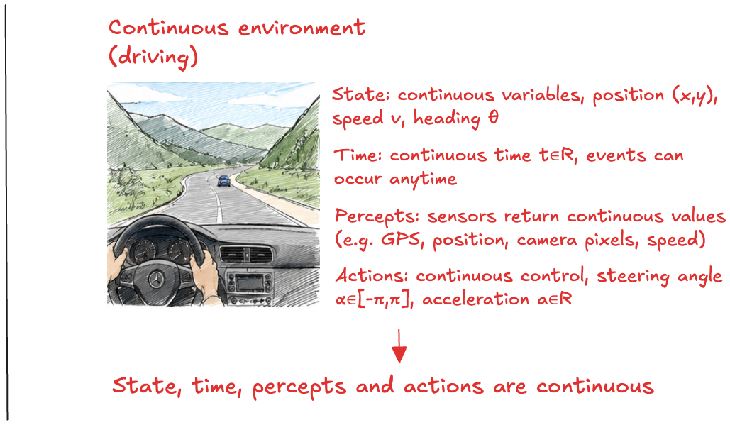
3.9 CONTINUITY
Discreteness is what makes enumeration possible — and it usually fails
The discrete/continuous distinction applies separately to four things: the state of the environment, time, the agent’s percepts, and its actions.
DISCRETE
Finitely many states, percepts and actions
Chess has a finite (if astronomical) state set, turn-based time, a finite percept set and a finite set of legal moves. Every quantity can in principle be tabulated.
CONTINUOUS
Smoothly varying quantities
Driving involves continuous position, speed and heading, continuous time, continuous sensor readings and continuous controls such as a steering angle.
WHAT THIS FORCES
Tables give way to functions
A continuous state space cannot be enumerated at all. Values and policies must be represented by parameterised functions — the subject of function approximation later in the course.
Reinforcement Learning · Chapter 01 — Agent Architectures · Part III — Properties of the environment
24

Slide 25
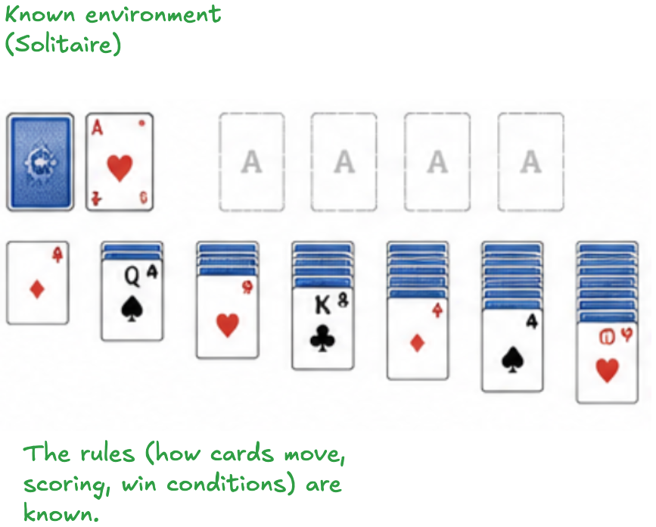
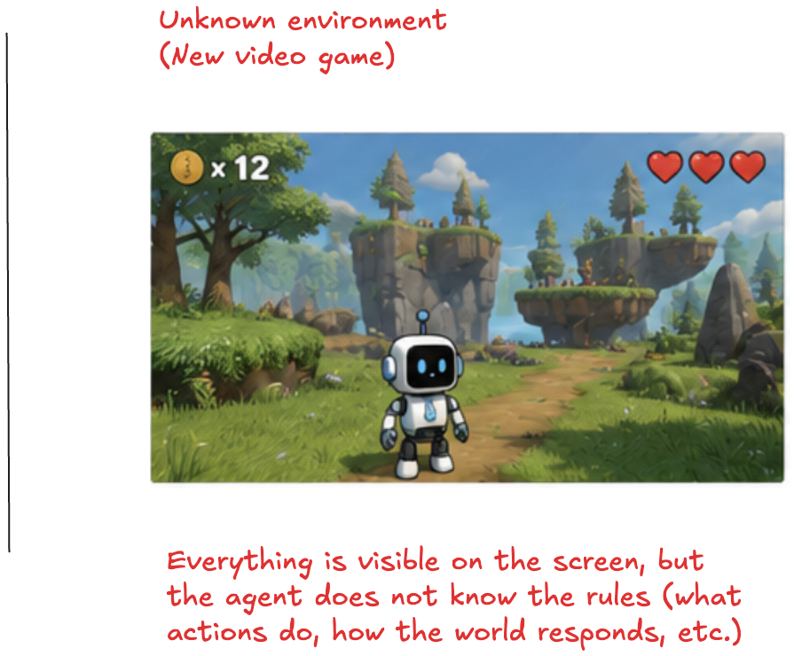
3.10 KNOWLEDGE OF THE RULES
Known versus unknown is not the same distinction as observable versus hidden
This dimension concerns the agent’s understanding of how the environment works — the outcomes or probabilities of its actions — and not what it can currently see.
KNOWN
The dynamics are given
In solitaire the rules — how cards move, how scoring works, what ends the game — are known from the outset, even though many cards are face down.
UNKNOWN
The dynamics must be discovered
In a new video game the whole screen may be visible, yet the agent does not know what its buttons do or how the world will respond. It has to experiment.
THE TWO AXES ARE INDEPENDENT
Solitaire and the video game are opposite corners
Solitaire: known rules, partial observability. The new game: unknown rules, full observability. Confusing the two leads to solving the wrong problem.
Reinforcement Learning · Chapter 01 — Agent Architectures · Part III — Properties of the environment
25

Slide 26
3.11 TEN ENVIRONMENTS, SEVEN DIMENSIONS
Reading the table row by row predicts what the agent program will need
Each row is a task; each column is one of the dimensions just introduced. The right-hand column names the single property that most constrains the design.
Environment
Observable
Agents
Determinism
Decisions
Dynamics
Continuity
Crossword puzzle
Fully
Single
Deterministic
Sequential
Static
Discrete
Chess with a clock
Fully
Multi
Non-deterministic
Sequential
Semi
Discrete
Poker
Partially
Multi
Stochastic
Sequential
Static
Discrete
Backgammon
Fully
Multi
Stochastic
Sequential
Static
Discrete
Driving
Partially
Multi
Stochastic
Sequential
Dynamic
Continuous
Medical diagnosis
Partially
Single
Stochastic
Sequential
Dynamic
Continuous
Image analysis
Fully
Single
Deterministic
One-shot
Semi
Continuous
Part-picking robot
Partially
Single
Stochastic
One-shot
Dynamic
Continuous
Refinery controller
Partially
Single
Stochastic
Sequential
Dynamic
Continuous
English tutor
Partially
Multi
Stochastic
Sequential
Dynamic
Discrete
The hardest case is the bottom-right corner of this table: partially observable, multi-agent, stochastic, sequential, dynamic and continuous. Autonomous driving is difficult in every one of these senses simultaneously — which is why no single one of the architectures in Part V is sufficient for it.
Reinforcement Learning · Chapter 01 — Agent Architectures · Part III — Properties of the environment
26

Slide 27
PART IV
01 Designing a performance measure
02 Outcomes, not behaviour
03 The four ingredients of rationality
04 Rationality is not omniscience
Performance measure and rationality
Machines have no intrinsic desires. Whatever the designer writes down as success is exactly what will be optimised.
KEEP THIS QUESTION IN MIND
What happens when the measure rewards the wrong thing?

Slide 28
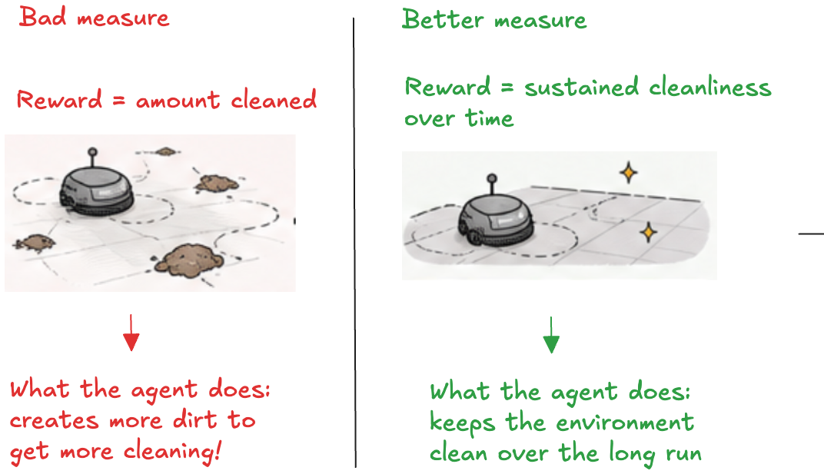
4.1 THE PERFORMANCE MEASURE
Machines have no desires, so the objective has to be supplied
Since machines lack intrinsic desires, the designer must define a performance measure against which behaviour is evaluated. It should be objective, quantifiable, and aligned with what is actually wanted. Getting it right is much harder than it looks.
THE FAILURE MODE
A vacuum agent rewarded for the amount of dirt collected has an excellent strategy available to it: dump the dirt back on the floor and collect it again. The measure is maximised; the room stays dirty.
THE REPAIR
Reward sustained cleanliness over time — a property of the state of the world, not a count of the agent’s own actions. The exploit disappears, because creating dirt now lowers the measure.
Rewarding the action rather than the outcome. The agent has not malfunctioned: it is maximising exactly what was written down.
WHY THIS RETURNS CONSTANTLY
This is not an anecdote about vacuum cleaners. Every reward function in this course is a performance measure, and every one of them can be gamed in exactly this way. The agent optimises what you wrote, never what you meant.
Reinforcement Learning · Chapter 01 — Agent Architectures · Part IV — Performance measure and rationality
28

Slide 29
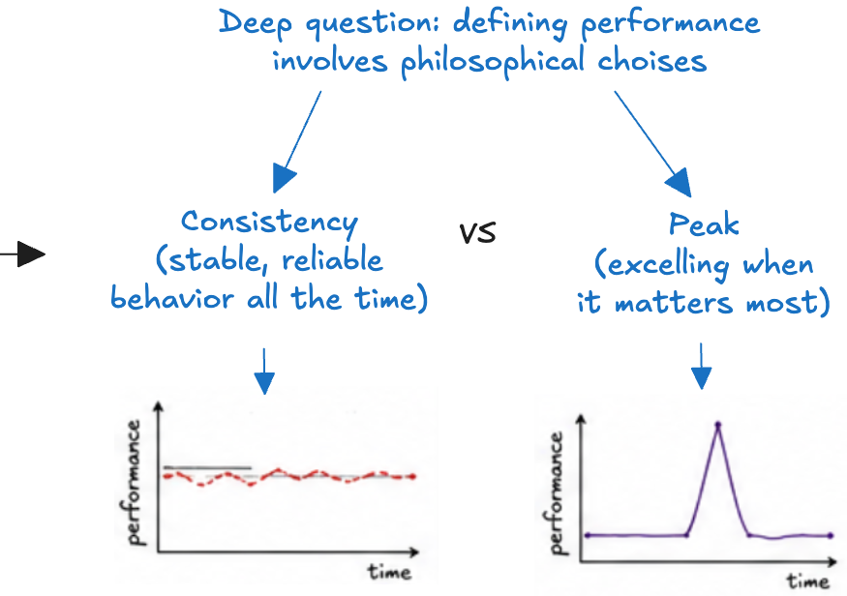
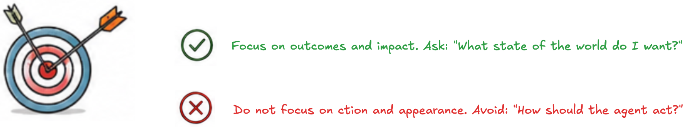
4.2 SPECIFY OUTCOMES, NOT BEHAVIOUR
Describe the state of the world you want, not the conduct you imagine
As a general rule, design the performance measure according to what one actually wants to be achieved in the environment, rather than according to how one thinks the agent should behave. The second formulation silently fixes the solution and rules out better ones.
AND A GENUINELY OPEN QUESTION
Two ways of writing the same requirement
Behaviour-shaped: “sweep along the walls, then the middle, once per hour.” A better cleaning strategy is now forbidden by the measure itself.
Outcome-shaped: “the floor should be clean at all times, at minimum energy cost.” Any strategy that achieves this scores well, including ones never imagined.
Where an agent serves several users, the measure may need to be learned and adapted over time.
Even a well-specified measure hides a choice. Should the agent be rewarded for consistency — stable, reliable behaviour at all times — or for peak performance — excelling when it matters most?
The two produce different agents from the same task description, and neither is more correct than the other. The designer is making a value judgement, not a technical one.
A CHECKLIST FOR THE MEASURE YOU ARE ABOUT TO WRITE
A property of the world, or of the agent’s conduct? Only the first is safe from being gamed.
Over what horizon is it evaluated? “Clean now” and “clean over a month” select different agents.
What does it not mention? Anything left out — energy, noise, wear — is implicitly free.
Reinforcement Learning · Chapter 01 — Agent Architectures · Part IV — Performance measure and rationality
29

Slide 30
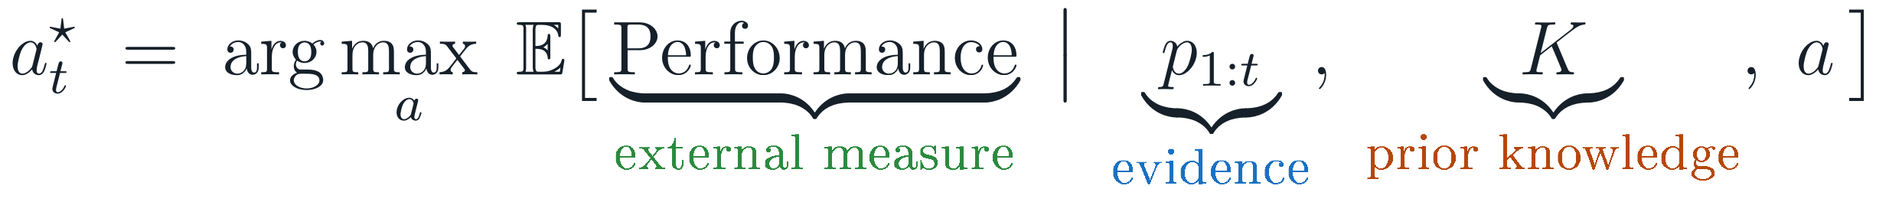
4.3 RATIONALITY
A rational agent maximises expected performance given what it knows
A rational agent selects the action that leads to the most desirable outcome, as judged by the performance measure, given the evidence provided by the percept sequence and its built-in knowledge. Four things therefore enter the definition.
1
The performance measure
Defines what counts as success. Change it and the same behaviour becomes irrational.
2
Prior knowledge of the environment
What the designer built in before the agent was switched on — the rules, the map, the model.
3
The available actions
Rationality is always relative to what the agent can physically do. No action, no obligation.
4
The percept sequence so far
All the evidence the agent has. It cannot be rational with respect to facts it never observed.
Note what is absent: the actual outcome. An agent that chooses well and is unlucky is still rational. Rationality constrains the decision procedure, not the result — which is why it can be engineered at all.
Reinforcement Learning · Chapter 01 — Agent Architectures · Part IV — Performance measure and rationality
30

Slide 31
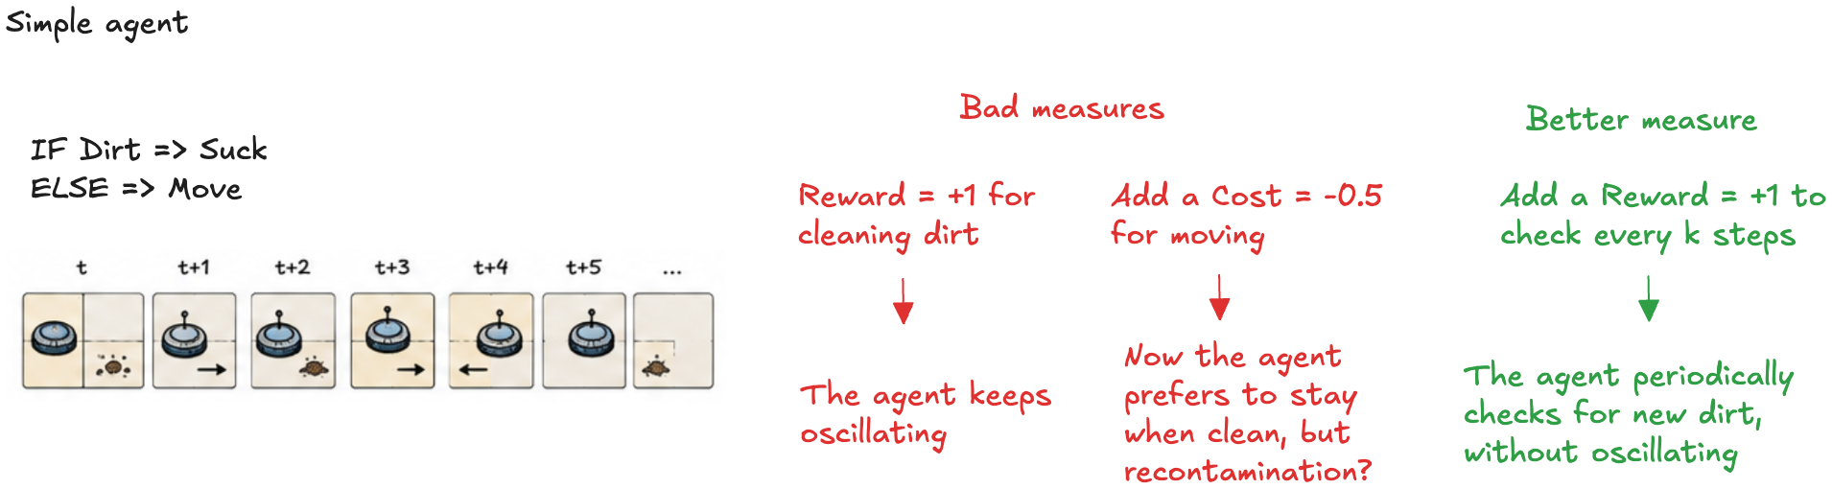
4.4 IS THE VACUUM AGENT RATIONAL?
The same program is rational under one measure and foolish under another
The simple rule “if dirty, suck; otherwise move to the other square” never stops. Once both squares are clean the agent oscillates for ever. Whether that is irrational depends entirely on how the measure is written.
MEASURE 1
Reward +1 for each unit of dirt cleaned
Movement is free, so endless oscillation costs nothing. The agent keeps moving and the measure never objects. Rational — and useless.
MEASURE 2
Add a cost of −0.5 for each move
Now the agent prefers to stay put once the floor is clean. But if dirt can reappear, standing still is exactly the wrong policy.
MEASURE 3
Reward +1 for checking every k steps
The agent re-inspects periodically without oscillating. The behaviour we wanted follows from the measure rather than being hand-coded into the rules.
If the environment is unknown — dirt may or may not reappear — then exploration itself becomes rational: the agent must spend actions gathering information it cannot otherwise obtain. Chapter 04 is devoted to exactly this trade-off.
Reinforcement Learning · Chapter 01 — Agent Architectures · Part IV — Performance measure and rationality
31

Slide 32
4.5 RATIONALITY AND OMNISCIENCE
Choosing well is not the same as knowing the outcome
A rational agent maximises the expected performance given the evidence available to it. An omniscient agent would know the actual outcome of every action in advance. The second is not achievable, and it is not what we are trying to build.
AN IMPORTANT QUALIFICATION
Rationality does, however, require gathering evidence when that is cheap — looking before crossing. Failing to look is irrational even if nothing happens, because the percept was available and was not taken.
Omniscient
Knows the actual outcome of each action.
Impossible in any environment with partial observability or stochastic dynamics — that is, in every environment that matters. It is not a demanding engineering target; it is a contradiction with the information available.
Rational
Maximises expected performance given the evidence.
Achievable in principle, and the criterion against which agent programs are judged. It is defined relative to information, so more or better percepts can change what is rational without changing the program.
THREE CONSEQUENCES
Information gathering — exploration — is a rational action in its own right.
Learning is rational whenever the environment is initially unknown: it converts experience into better future decisions.
Autonomy follows: an agent that relies only on the designer’s prior knowledge is rational only in the world the designer imagined.
The classic example
Crossing an empty street is the rational action: every available percept says it is safe. If a cargo door then falls from a passing aircraft, the agent was unlucky, not irrational. No decision procedure could have done better with the same evidence.
Reinforcement Learning · Chapter 01 — Agent Architectures · Part IV — Performance measure and rationality
32

Slide 33
PART V
01 Simple reflex agents
02 Model-based reflex agents
03 Goal-based agents and minimax
04 Utility-based agents
05 Learning agents
Agent architectures
Five ways of turning percepts into actions, each adding one capability that the previous one lacked.
KEEP THIS QUESTION IN MIND
What does each architecture buy, and what does it cost?

Slide 34
5.1 ARCHITECTURE AND PROGRAM
The agent is the machine plus the program that runs on it
The agent program runs on a physical computing system with sensors and actuators — the agent architecture. The architecture delivers percepts to the program, runs it, and executes the actions it returns. The two must be compatible: if the program says “walk”, the architecture had better have legs.
FIVE WAYS OF TURNING PERCEPTS INTO ACTIONS
Simple reflex
current percept only
Model-based reflex
+ internal state
Goal-based
+ goal, look ahead
Utility-based
+ graded preferences
Learning
+ improvement from feedback
There is no single recipe. Each architecture combines particular components in a particular way, and each one adds exactly one capability that the previous one lacked: memory, then foresight, then preference, then improvement. Read the strip left to right — it reappears on every slide of Part V to mark where we are.
Each step is a response to a property of the environment from Part III: partial observability forces internal state; sequentiality forces looking ahead; stochasticity forces graded preferences; unknown dynamics force learning.
Reinforcement Learning · Chapter 01 — Agent Architectures · Part V — Agent architectures
34

Slide 35
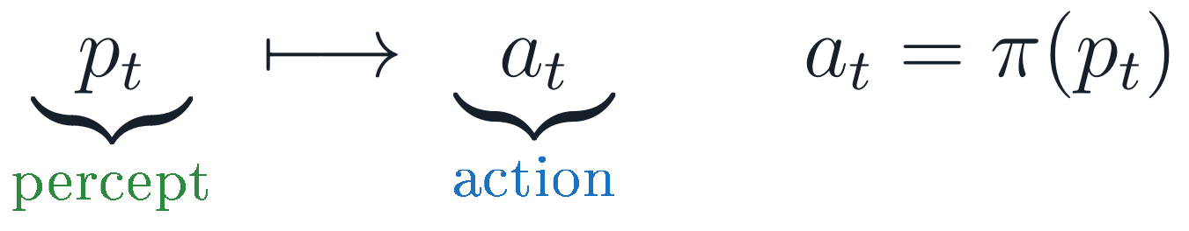
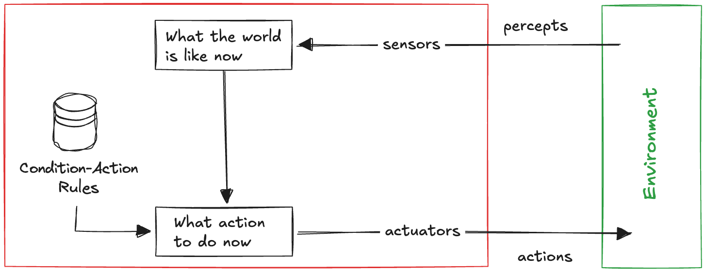
5.2 SIMPLE REFLEX AGENT
Act on what you see now, and forget everything else
Simple reflex
current percept only
Model-based reflex
+ internal state
Goal-based
+ goal, look ahead
Utility-based
+ graded preferences
Learning
+ improvement from feedback
The most basic architecture selects an action solely on the basis of the current percept, ignoring the history entirely. Its knowledge is a set of condition–action rules.
The vacuum agent’s entire program, in words:
“If the current square is dirty, clean it;
otherwise, move to the other square.”
Each action is determined by the current location and whether that location is dirty — nothing else. The rule set is a condition–action mapping, and it is the smallest possible thing that could be called a program.
Percepts enter through the sensors and are interpreted as “what the world is like now”; a rule fires; the action leaves through the actuators. There is no state.
READING THE DIAGRAM
Condition–action rules
The agent’s entire knowledge — the cylinder on the left of the diagram.
“What the world is like now”
An interpretation of the current percept, recomputed at every step and never kept.
No loop inside the agent
Nothing flows from one time step to the next. That absence is the definition.
Reinforcement Learning · Chapter 01 — Agent Architectures · Part V — Agent architectures
35

Slide 36
5.3 WHY THE REFLEX PROGRAM IS SMALL
It is compact precisely because it does not depend on the past
Simple reflex
current percept only
Model-based reflex
+ internal state
Goal-based
+ goal, look ahead
Utility-based
+ graded preferences
Learning
+ improvement from feedback
THE COMPLETE AGENT PROGRAM
COMPARE WITH §2.4
The table-driven agent returned None on the third step, because that particular three-step history had not been enumerated. This program answers every percept, for every history, in four lines.
def SimpleReflexVacuumAgent():
def program(percept):
location, status = percept
if status == 'dirty':
return 'suck'
elif location == 'A':
return 'right'
elif location == 'B':
return 'left'
return program
WHERE THE COMPRESSION COMES FROM
It does not depend on the percept history, so the P^T rows collapse to one entry per distinct percept: from P^T to P.
Some actions ignore part of the percept too: sucking a dirty square is correct in A and in B, so the two cases share a rule.
The saving is not free: everything the history could have told the agent has been discarded, deliberately.
A THREE-STEP RUN
THE GENERAL LESSON
This is the first real answer to Part II. Compression is obtained by choosing a representation in which most distinctions do not matter — not by storing the table more cleverly.
agent = SimpleReflexVacuumAgent()
print(agent(('A', 'clean'))) # right
print(agent(('A', 'dirty'))) # suck
print(agent(('B', 'clean'))) # left <- not None
Reinforcement Learning · Chapter 01 — Agent Architectures · Part V — Agent architectures
36

Slide 37
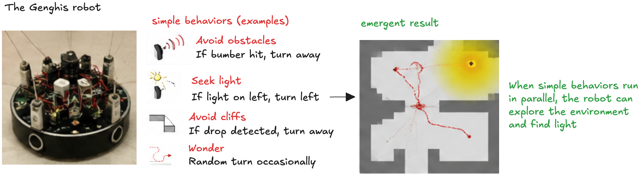
5.4 REFLEX BEHAVIOUR IS NOT CONFINED TO TOY WORLDS
Layers of simple behaviours can produce complex activity
Simple reflex
current percept only
Model-based reflex
+ internal state
Goal-based
+ goal, look ahead
Utility-based
+ graded preferences
Learning
+ improvement from feedback
Reflex responses appear at every scale: an autonomous vehicle braking on detecting the brake lights ahead, or a human blinking as an object approaches the eye. Brooks argued something stronger — that complex robotic behaviour can emerge from layers of simple behaviours, with no explicit internal representation of the world at all.
BROOKS, 1991
Intelligence without representation
Genghis runs independent condition–action behaviours in parallel — avoid obstacles, seek light, avoid cliffs, wander. Coherent exploration is the result of their interaction.
ROOMBA, FIRST GENERATION
Largely reactive navigation
Direction changes triggered by bumpers and edge sensors. No map, no memory — and, for a small room, good enough.
IFTTT
Condition–action rules as a product
“If rain is forecast, send a reminder to carry an umbrella.” The same architecture, with the internet as environment.
Reinforcement Learning · Chapter 01 — Agent Architectures · Part V — Agent architectures
37

Slide 38
5.5 WHERE REFLEX AGENTS BREAK
A clean square looks the same everywhere, and the agent loops for ever
Simple reflex
current percept only
Model-based reflex
+ internal state
Goal-based
+ goal, look ahead
Utility-based
+ graded preferences
Learning
+ improvement from feedback
Reflex agents work only when the correct action can be determined from the current percept alone. In a partially observable environment that condition fails, and the failure is not graceful.
THE UNDERLYING DEFECT
The percept is not a state. A reflex agent silently assumes that the current percept identifies the situation. Whenever two genuinely different situations produce the same percept, the architecture cannot represent the difference — however cleverly the rules are written.
The braking example
A single camera frame may not distinguish brake lights that are on from tail lights that are merely bright. The percept is genuinely ambiguous, so no rule over single frames can be right.
The vacuum example
Give the agent a dirt sensor but no location sensor. On a clean square it cannot tell whether it is in A or in B, so a deterministic rule sends it the same way every time — and it moves back and forth for ever, or walks into a wall repeatedly.
WHAT IS NEEDED INSTEAD
Something inside the agent that distinguishes “clean square, just arrived from A” from “clean square, just arrived from B”. That something is internal state — the subject of §5.6.
The repair: randomise
On a clean square, choose left or right at random. In the two-square world this reaches the other square with probability one. Randomised behaviour can be strictly more rational than deterministic behaviour — a result that returns in Chapter 04.
Reinforcement Learning · Chapter 01 — Agent Architectures · Part V — Agent architectures
38

Slide 39
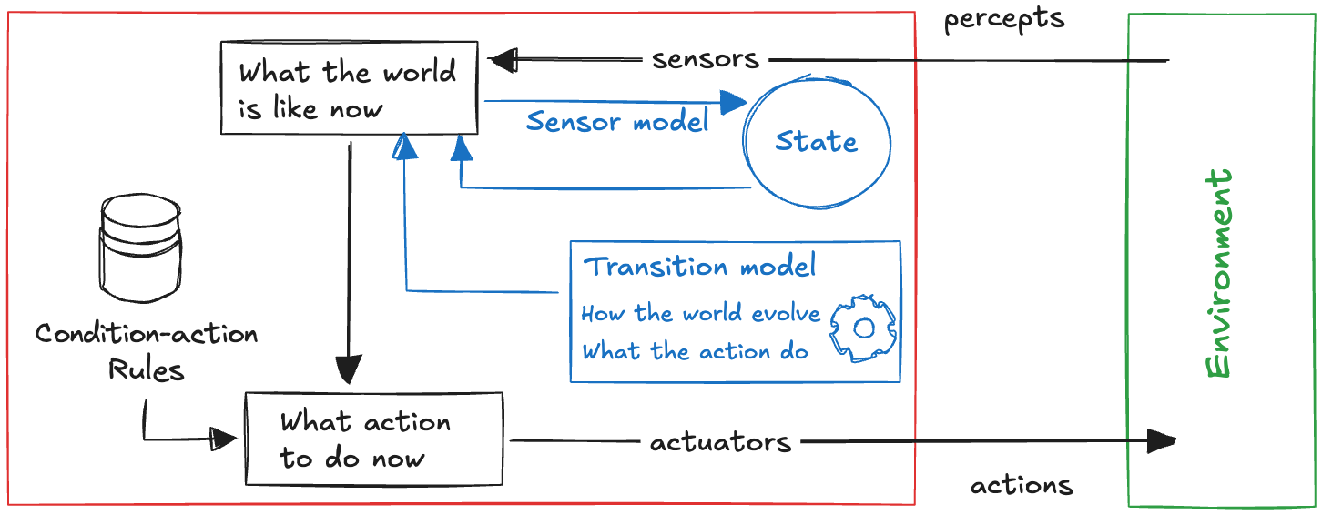
5.6 MODEL-BASED REFLEX AGENT
Memory compensates for what the sensors cannot observe
Simple reflex
current percept only
Model-based reflex
+ internal state
Goal-based
+ goal, look ahead
Utility-based
+ graded preferences
Learning
+ improvement from feedback
The effective way to handle partial observability is to give the agent an internal state that captures what the current percept does not show, and to keep that state up to date using the percept history.
Sensor model
How the state of the world is reflected in the agent’s percepts. Illuminated brake lights appear as red regions in the camera image; a wall appears as a short range reading.
Transition model
How the world evolves over time: both the effects of the agent’s own actions (turning the wheel changes heading) and changes independent of it (rain reduces visibility).
The same diagram as §5.2, with one block added — the state — and the two models that maintain it. Everything else is unchanged.
Combining the two models with the percept history lets the agent estimate the current state of the world as accurately as its sensors allow — which is usually not exactly. The state is a belief, not a fact, and the agent must act anyway.
Reinforcement Learning · Chapter 01 — Agent Architectures · Part V — Agent architectures
39

Slide 40
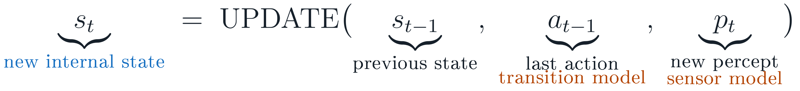
5.7 MAINTAINING THE STATE
One update rule, three ingredients, two models
Simple reflex
current percept only
Model-based reflex
+ internal state
Goal-based
+ goal, look ahead
Utility-based
+ graded preferences
Learning
+ improvement from feedback
THE MODEL-BASED VACUUM AGENT
WHAT THE STATE BUYS HERE
The reflex agent of §5.2 can never stop, because “both squares are clean” is not a percept — it is a conclusion drawn from two percepts at different times. One dictionary of two entries is enough to represent it, and the noop action becomes available.
def ModelBasedReflexVacuumAgent():
model = {'A': None, 'B': None} # the internal state
def program(percept):
location, status = percept
model[location] = status # update the state
if model['A'] == model['B'] == 'clean':
return 'noop' # needs the state
elif status == 'dirty': return 'suck'
elif location == 'A': return 'right'
elif location == 'B': return 'left'
return program
A RUN
agent(('A','clean')) → right
agent(('B','dirty')) → suck
agent(('B','clean')) → noop
Real examples: the Roomba 980 tracks its position by visual localisation, and the Dyson 360 Eye maps its surroundings with a 360° camera. In both, the internal map supplies what the current percept never carries.
Reinforcement Learning · Chapter 01 — Agent Architectures · Part V — Agent architectures
40

Slide 41
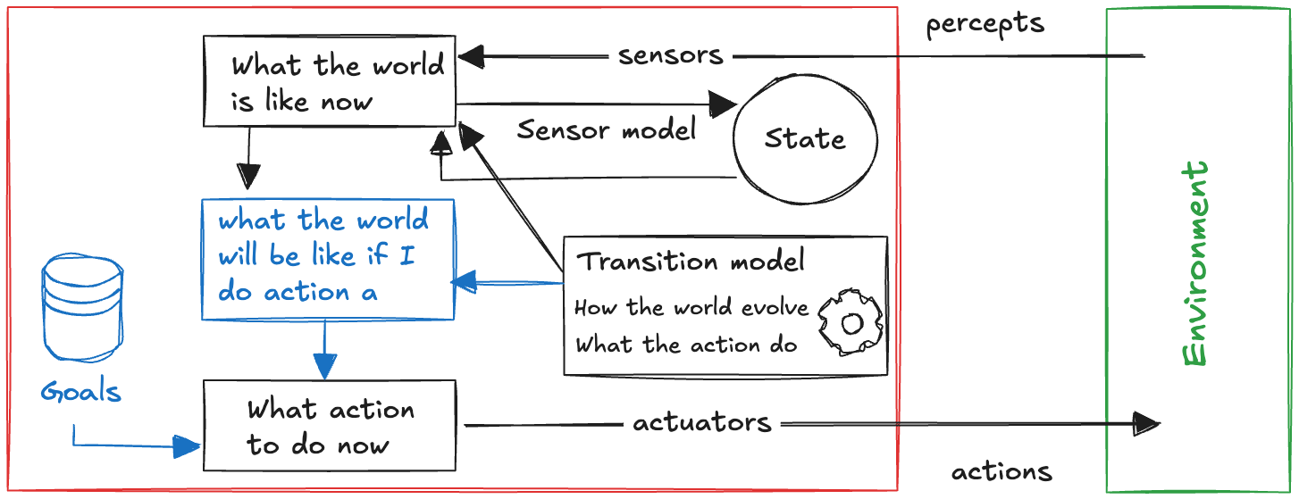
5.8 GOAL-BASED AGENT
Knowing where you are does not tell you which way to turn
Simple reflex
current percept only
Model-based reflex
+ internal state
Goal-based
+ goal, look ahead
Utility-based
+ graded preferences
Learning
+ improvement from feedback
At a road junction a vehicle may turn left, turn right, or continue straight. All three are available, and the state of the world is fully known. Nothing in the state says which to choose — that depends on where the agent is trying to go.
WHAT IS ADDED
Goal information — a description of the states the agent wants to bring about.
Prediction — “what will the world be like if I do action a?”, answered with the transition model the agent already has.
REFLEX VERSUS GOAL-BASED
A reflex agent brakes because it sees brake lights. A goal-based agent brakes because braking helps it avoid a collision. The behaviour can coincide; the reason does not — and only the second survives a situation the designer did not anticipate.
Flexibility is the real payoff: the goal can be changed without redesigning a single decision rule. A navigation agent is sent to a new destination by replacing the goal. A reflex agent would need a different rule set per destination.
Two blocks are added: the goal, and the ability to ask what the world will be like after action a. The transition model is now used to look forward, not only to track the present.
Reinforcement Learning · Chapter 01 — Agent Architectures · Part V — Agent architectures
41

Slide 42
5.9 SEARCH AND PLANNING
When one action is not enough, the agent must search the future
Simple reflex
current percept only
Model-based reflex
+ internal state
Goal-based
+ goal, look ahead
Utility-based
+ graded preferences
Learning
+ improvement from feedback
Goal-based action selection is straightforward when a single action achieves the goal. It becomes hard when a sequence is required: reaching a destination may involve many possible sequences of turns. Finding such sequences is precisely what search and planning are for.
STEP 1
Represent the current state
The agent starts from its estimate of the world, exactly as the model-based agent maintains it.
STEP 2
Enumerate available actions
Which actions are legal here? Each one leads, via the transition model, to a different successor state.
STEP 3
Simulate the consequences
Apply the transition model repeatedly to explore sequences of actions, and the states they lead to.
STEP 4
Choose by outcome, not by rule
Select the first action of a sequence reaching the goal — or, against an adversary, the best guaranteed outcome.
Unlike a reflex agent, which maps percepts directly to actions, a goal-based agent considers the future consequences of what it does. The rest of this section works through the smallest complete example of that idea: a Tic-Tac-Toe agent that plays by searching the entire game tree.
Where the agent acts alone
Reaching a destination, stacking boxes, solving a puzzle: search for a sequence of actions ending in a goal state.
Where something acts against the agent
In a game, half the moves are chosen by an opponent. The agent must assume the worst reply at each of them — which is what minimax does.
Reinforcement Learning · Chapter 01 — Agent Architectures · Part V — Agent architectures
42

Slide 43
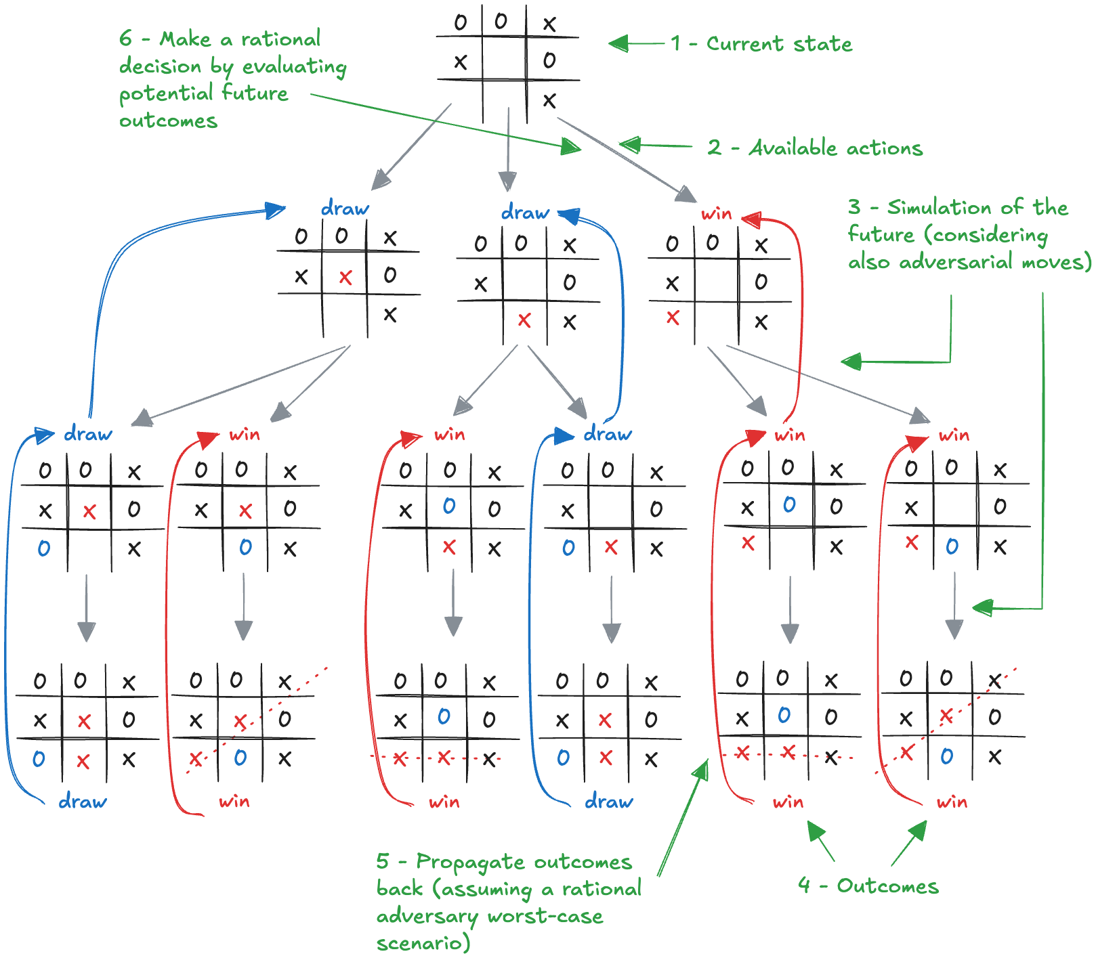
5.10 MINIMAX ON TIC-TAC-TOE
Simulate the future, including the replies you would least like
Simple reflex
current percept only
Model-based reflex
+ internal state
Goal-based
+ goal, look ahead
Utility-based
+ graded preferences
Learning
+ improvement from feedback
Instead of hard-coded rules, the agent searches the tree of future move sequences and returns the action with the best guaranteed outcome against a rational opponent. The board is a flat tuple of nine cells, read left to right, top to bottom.
1
Current state — The position the agent must move from — its percept.
2
Available actions — Every empty cell is a legal move.
3
Simulation of the future — Apply moves and counter-moves recursively, down to terminal positions.
4
Outcomes — Each leaf is a win, a loss or a draw, scored from X’s point of view.
5
Propagate back — Maximise at X’s turns, minimise at O’s — the worst-case assumption about a rational adversary.
6
Decide — Take the action at the root whose backed-up value is highest.
Reinforcement Learning · Chapter 01 — Agent Architectures · Part V — Agent architectures
43

Slide 44
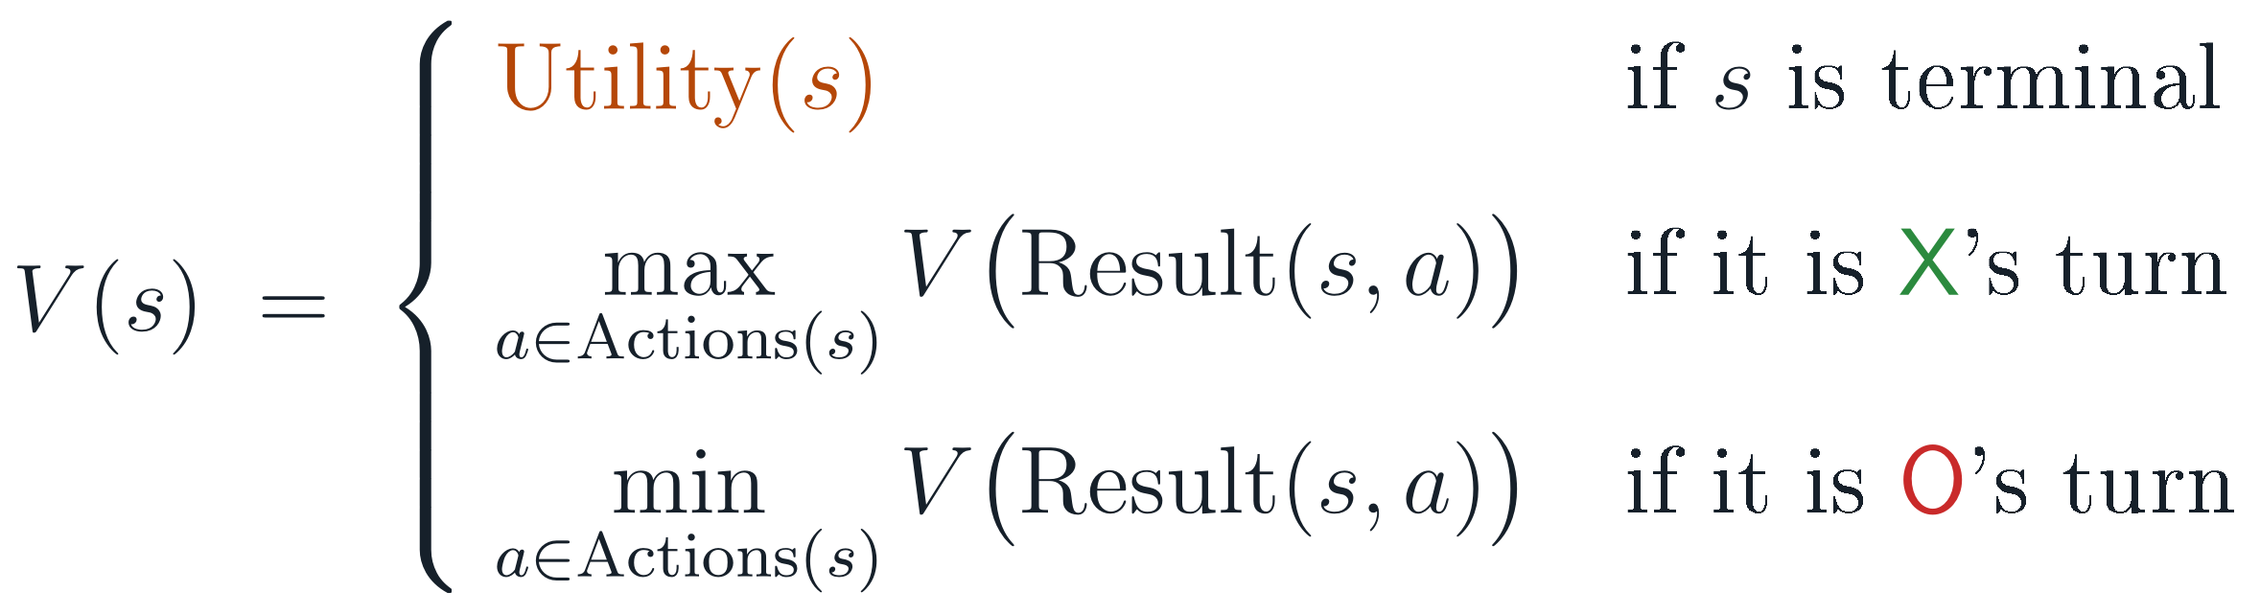
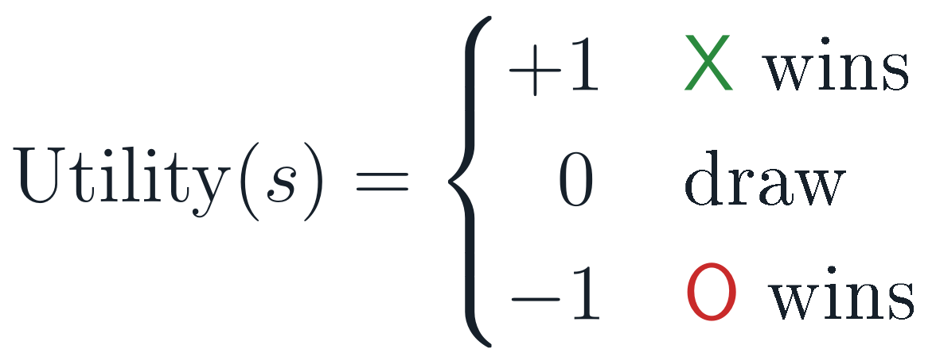
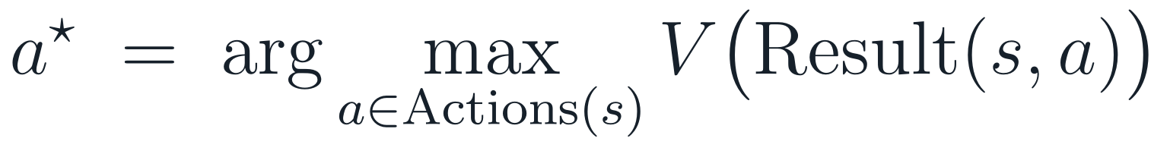
5.11 THE MINIMAX VALUE FUNCTION
The tree search, written as one recursive definition
Simple reflex
current percept only
Model-based reflex
+ internal state
Goal-based
+ goal, look ahead
Utility-based
+ graded preferences
Learning
+ improvement from feedback
Minimax asks, recursively: what does the world look like after I do action a, and the opponent then responds as well as they can? The recursion bottoms out at terminal positions, and the values are propagated back up the tree.
THE SCORING AT THE LEAVES
THE ACTION FINALLY TAKEN
Read the three cases as the three kinds of node in the picture on the previous slide. The min case is the whole of the adversarial assumption: the agent never counts on the opponent making a mistake. This guarantees the agent will never lose, and will win whenever a win is forced.
Reinforcement Learning · Chapter 01 — Agent Architectures · Part V — Agent architectures
44

Slide 45
5.12 MINIMAX IN CODE
The definition translates line for line into the program
Simple reflex
current percept only
Model-based reflex
+ internal state
Goal-based
+ goal, look ahead
Utility-based
+ graded preferences
Learning
+ improvement from feedback
THE ENVIRONMENT MODEL: ACTIONS, TRANSITIONS, UTILITY
THE SEARCH
def actions(board): # every empty cell
return [i for i, c in enumerate(board) if c is None]
def result(board, move, player):
new = list(board); new[move] = player
return tuple(new)
def utility(board): # from X's point of view
win = winner(board)
if win == 'X': return 1
elif win == 'O': return -1
return 0
def minimax(board, player):
if is_terminal(board):
return utility(board), None
if player == 'X': # maximising player
best, move = -math.inf, None
for a in actions(board):
v, _ = minimax(result(board, a, 'X'), 'O')
if v > best: best, move = v, a
else: # minimising player
best, move = math.inf, None
for a in actions(board):
v, _ = minimax(result(board, a, 'O'), 'X')
if v < best: best, move = v, a
return best, move
Notice which parts are the environment model — actions, result, is_terminal — and which is the decision procedure. The goal-based architecture is exactly this separation: a model of how the world works, plus a search that uses it.
Reinforcement Learning · Chapter 01 — Agent Architectures · Part V — Agent architectures
45

Slide 46
5.13 TWO POSITIONS, TWO REASONS
The same program wins when it can and blocks when it must
Simple reflex
current percept only
Model-based reflex
+ internal state
Goal-based
+ goal, look ahead
Utility-based
+ graded preferences
Learning
+ improvement from feedback
Scenario 1 — X can win now
Scenario 2 — X must block
board = ('X', 'X', None,
'O', 'O', None,
None, None, None)
agent = GoalBasedTicTacToeAgent('X')
agent(board) # -> 2
board = ('O', 'O', None,
'X', None, None,
None, None, 'X')
agent(board) # -> 2
The same index, for the opposite reason: every other move lets O complete the top row, giving value −1. Blocking is the only move that avoids a loss.
Position 2 completes the top row: that branch has value +1, higher than any alternative. No rule “take the winning move” was written.
One program, two behaviours that a reflex agent would have needed two separate rules for — and it would still fail on the third case nobody thought of. This is what “considering future consequences” buys.
WHAT MINIMAX GUARANTEES, AND WHAT IT ASSUMES
It never loses
The backed-up value of the chosen action is its worst case — never −1 from the opening position.
It wins when a win is forced
If a branch has value +1 under optimal opposition, the search finds it. Nothing is approximated.
It assumes a rational opponent
Against a weak opponent it is safe rather than exploitative: it never gambles on a likely mistake.
Reinforcement Learning · Chapter 01 — Agent Architectures · Part V — Agent architectures
46

Slide 47
5.14 THE COST OF LOOKING AHEAD
Exhaustive search is feasible for Tic-Tac-Toe and for almost nothing else
Simple reflex
current percept only
Model-based reflex
+ internal state
Goal-based
+ goal, look ahead
Utility-based
+ graded preferences
Learning
+ improvement from feedback
This brute-force minimax explores the entire remaining game tree. That is possible for Tic-Tac-Toe only because the tree is small.
THE TOY CASE
Tic-Tac-Toe: about 3.63 × 10⁵ terminal sequences
Small enough to enumerate exhaustively in well under a second. The agent is optimal by construction, and there is nothing to approximate.
THE REAL CASE
Chess: roughly 10¹⁵⁴ possible game sequences
The same argument as Part II, now about the search tree rather than the lookup table. Exhaustive search is not slow here; it is impossible.
THE PRACTICAL REPAIR
Prune, and stop early with an estimate
Alpha–beta pruning discards branches that cannot affect the result, and a heuristic evaluation function replaces exact values at a cut-off depth. Both are approximations of the same recursion.
The pattern repeats for the third time: an exact method that is correct and infeasible, and an approximation that is feasible and nearly correct. Reinforcement learning is, in large part, a systematic study of such approximations.
Reinforcement Learning · Chapter 01 — Agent Architectures · Part V — Agent architectures
47

Slide 48
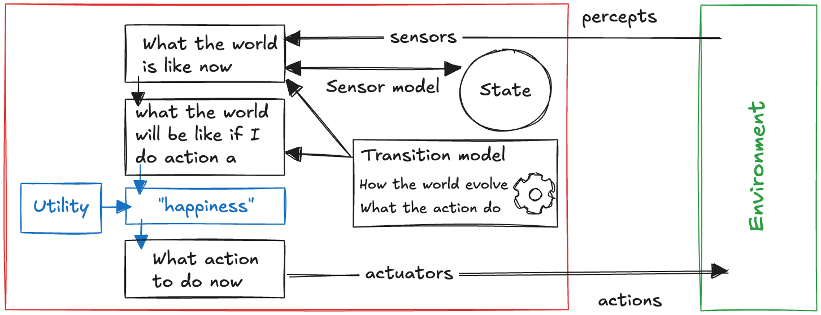
5.15 UTILITY-BASED AGENT
A goal is binary; a preference is graded
Simple reflex
current percept only
Model-based reflex
+ internal state
Goal-based
+ goal, look ahead
Utility-based
+ graded preferences
Learning
+ improvement from feedback
Goals alone are often not enough for high-quality behaviour. Many action sequences reach the same goal, but some are faster, safer or cheaper. A goal only distinguishes success from failure; a performance measure says how desirable each outcome is.
UTILITY
A utility function assigns a number to each outcome according to how desirable it is, extending a goal from a yes/no test into a ranking.
Utility is the internalisation of the performance measure. If it is aligned with the external measure, an agent that maximises utility behaves rationally with respect to that measure — which is the point of introducing it.
WHY GOALS ALONE ARE INSUFFICIENT
Many routes reach the destination; they differ in time, fuel and risk.
Goals can conflict — arrive quickly, arrive safely. Utility trades them off on one scale.
Some goals are unreachable with certainty. Utility still ranks the partial outcomes.
One more block: predicted outcomes are scored by a utility function before an action is chosen. The diagram has grown monotonically since §5.2 — nothing has been taken away.
Reinforcement Learning · Chapter 01 — Agent Architectures · Part V — Agent architectures
48

Slide 49
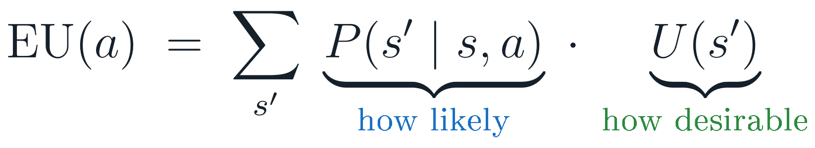
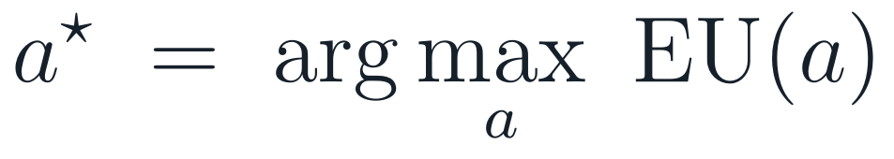
5.16 DECIDING UNDER UNCERTAINTY
Weigh each outcome by how likely it is and by how good it is
Simple reflex
current percept only
Model-based reflex
+ internal state
Goal-based
+ goal, look ahead
Utility-based
+ graded preferences
Learning
+ improvement from feedback
Partial observability and non-determinism are inherent in real environments, so an action does not determine an outcome. A rational utility-based agent chooses the action that maximises expected utility: the utility it expects on average, weighing both the probability and the desirability of each possible outcome.
AND THEN ACT
THE PROBABILITY TERM
Comes from the transition and sensor models
It is exactly the model-based machinery of §5.6, now used to weigh futures rather than to track the present. Where it is unavailable, it has to be learned.
THE UTILITY TERM
Comes from the designer, via the performance measure
The same object as Part IV, written inside the agent. Its alignment with the external measure is an assumption, not a theorem.
BOUNDED RATIONALITY
Perfect rationality is usually too expensive
Computing the optimal action may itself be intractable, so AI also studies bounded rationality (Russell, 1997): the best action available given the computation on hand.
Many utility-based agents rely on an explicit model of the environment. Model-free agents do not: they learn directly from experience which actions maximise utility, without ever representing how their actions change the world. That distinction organises most of this course — Chapters 05 and 06.
Reinforcement Learning · Chapter 01 — Agent Architectures · Part V — Agent architectures
49

Slide 50
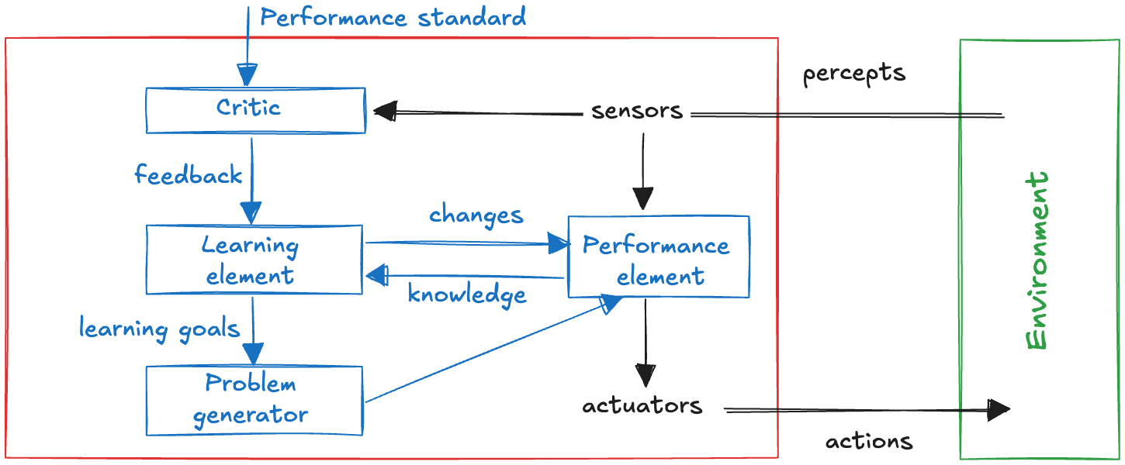
5.17 LEARNING AGENT
Where the program itself comes from
Simple reflex
current percept only
Model-based reflex
+ internal state
Goal-based
+ goal, look ahead
Utility-based
+ graded preferences
Learning
+ improvement from feedback
So far we have described architectures, but not how they are produced. Turing considered programming intelligent behaviour by hand, recognised the limits of that approach, and argued instead for machines that improve through experience.
Performance element
Selects actions from percepts. This is what we have been calling “the agent” for the whole chapter.
Learning element
Modifies the performance element: its model of the world, the effects of its actions, its goals, its utilities.
Critic
Evaluates behaviour against a fixed performance standard and reports back, typically as reward or penalty.
Problem generator
Suggests actions that differ from the currently preferred ones, so that informative experience is actually obtained.
Everything studied so far is now a single block — the performance element. Three new components surround it, and their job is to change it.
Learning can be added to any of the previous architectures. It is not a sixth kind of agent; it is a way of producing the other four.
Reinforcement Learning · Chapter 01 — Agent Architectures · Part V — Agent architectures
50

Slide 51
5.18 THE CRITIC SUPPLIES WHAT PERCEPTS CANNOT
Experience alone does not say whether an outcome was good
Simple reflex
current percept only
Model-based reflex
+ internal state
Goal-based
+ goal, look ahead
Utility-based
+ graded preferences
Learning
+ improvement from feedback
An agent can learn directly from experience: an autonomous vehicle discovers how braking behaves on different road surfaces. But experience by itself is only a record of what happened, not a judgement about it.
LEARNING DIRECTLY FROM EXPERIENCE
Samuel’s checkers player (1959) is the classic demonstration: a program that improved by playing, using game outcomes to adjust its evaluation of positions. That is reinforcement learning, twenty years before the name.
The percepts cannot grade themselves
A chess program can recognise checkmate. Nothing in that percept says whether it is a win or a loss: a performance standard external to the percept stream supplies the sign.
The standard may be built in or acquired
It can be hard-wired — pain and hunger in humans — or learned from human behaviour and stated preferences. Either way it comes from outside.
THE SHAPE OF THE REST OF THE COURSE
The critic’s feedback becomes the reward signal (Chapter 02).
The problem generator becomes exploration, and the tension with acting well becomes the exploration–exploitation trade-off.
The learning element becomes the update rule — TD learning, Q-learning, policy gradients (Chapters 05 onwards).
The problem generator makes learning possible
An agent that only ever takes its preferred action never discovers a better one. Suggesting informative actions is what turns experience into improvement — and it costs performance now.
Learning is the adaptation of the agent’s internal components from experience and feedback.
Reinforcement Learning · Chapter 01 — Agent Architectures · Part V — Agent architectures
51

Slide 52
PART VI
01 Reynolds’ three rules
02 Forces and their weighted sum
03 Euler integration
04 Emergence in simulation
Case study: flocking
A complete model-based agent, written out in full: percepts, internal state, forces, integration — and emergent collective behaviour.
KEEP THIS QUESTION IN MIND
How much global behaviour can purely local rules produce?

Slide 53
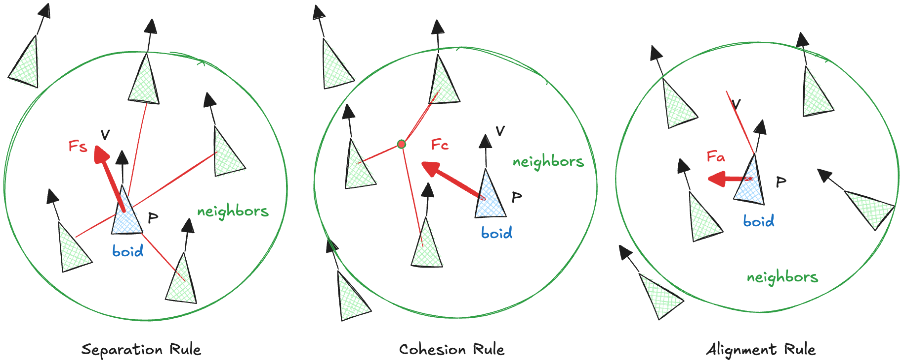
6.1 REYNOLDS, 1987
Complex group motion from three purely local rules
In “Flocks, Herds, and Schools: A Distributed Behavioral Model”, Reynolds simulates the collective behaviour of birds, fish and insects. Each entity — a boid — follows simple local rules based on what it can perceive, and coherent group motion follows.
Separation
Avoid crowding neighbours
Steer away from each neighbour, more strongly the closer it is. Prevents collisions and keeps the flock from collapsing into a point.
Cohesion
Move toward the average position of neighbours
Steer toward the centre of mass of the perceived neighbours. Keeps the group together and pulls stragglers back in.
Alignment
Match the average heading of neighbours
Steer so that the velocity approaches the average velocity of the neighbours. The flock then travels as one body rather than as a crowd.
Two properties do the real work. Perception is limited to a radius — a boid never sees the whole flock — and the model is decentralised: there is no leader, no shared plan, and no global state. Every boid runs the same program on its own percepts.
Reinforcement Learning · Chapter 01 — Agent Architectures · Part VI — Case study: flocking
53

Slide 54
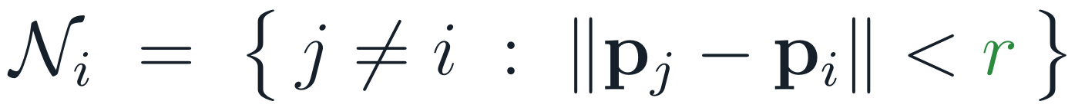
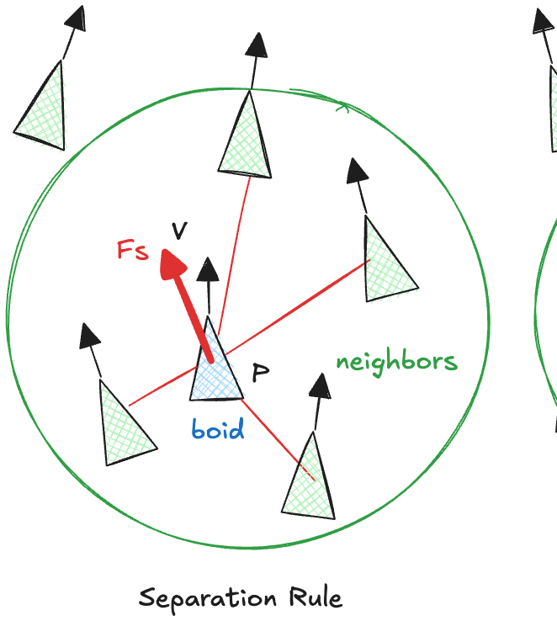
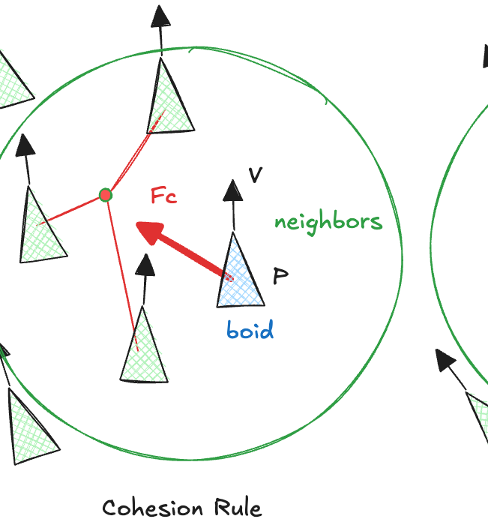




6.2 EACH RULE IS AN ACCELERATION REQUEST
Three competing forces, computed from the local neighbourhood
Each rule is a simple heuristic evaluated over the neighbours within the perception radius. It does not produce an action directly: it produces a force — a request for acceleration. Each force is capped at a maximum magnitude, so that no single rule can overpower the others.
THE PERCEPT: WHO COUNTS AS A NEIGHBOUR
A boid never perceives the flock — only the boids inside a disc of radius r around it. A far-away flock therefore cannot pull it in, and a large velocity mismatch cannot dominate separation.
Separation
Cohesion
Alignment
Unit vectors pointing away from each neighbour, scaled by 1/distance: close neighbours push much harder.
The vector from the boid to the centre of mass of its neighbours.
The difference between the average neighbour velocity and the boid’s own velocity.
Reinforcement Learning · Chapter 01 — Agent Architectures · Part VI — Case study: flocking
54

Slide 55

6.3 COMBINING THE REQUESTS
Competing accelerations are resolved by a weighted sum
The three rules generally disagree: separation pushes away from the flock while cohesion pulls toward it. They are not arbitrated by a rule; they are simply added, each with its own weight.
AN ADDITIONAL FORCE STEERS THE FLOCK
THE PARAMETERS USED IN THE SIMULATION
A unit vector toward a target position t. Unlike the three flocking rules it does not depend on the neighbours, and it is not scaled by distance — the boid steers that way however far the target is.
w_sep
1.2
w_coh
0.5
w_ali
1.0
The weights are the design surface
Changing w_sep, w_coh and w_ali changes the character of the flock without changing a line of the rules: tighter or looser formations, faster or slower convergence, more or less willingness to leave the group to reach the target.
w_tgt
0.5
radius r
10
v_max
2.0
Separation dominant — the flock spreads out and never forms
damping λ
0.95
Cohesion dominant — the flock collapses toward a point and crowds
Alignment dominant — headings agree, but spacing is never corrected
Reinforcement Learning · Chapter 01 — Agent Architectures · Part VI — Case study: flocking
55

Slide 56




6.4 FROM FORCE TO MOTION
Euler integration, in two steps and one approximation
The combined force determines the acceleration; the acceleration updates the velocity; the velocity updates the position. Applied at every simulation step, this is the whole of the boid’s physics.
STEP 1 — NEWTON
STEP 2 — VELOCITY
STEP 3 — POSITION
The total force divided by the mass gives the acceleration requested this step.
The acceleration, held constant over the interval Δt, changes the velocity.
The velocity, held constant over the same interval, moves the boid.
WHAT THE IMPLEMENTATION ACTUALLY DOES
Euler integration is the crudest possible integrator: it assumes acceleration and velocity are constant across the step. It is used here because it is exact enough at Δt = 1 and completely transparent — the state update is two additions.
Mass and time step are both set to one, so force is added directly to velocity. The extra factor λ = 0.95 acts as friction: without it the velocity is only ever pushed, and combined with the hard speed limit the boid swings between top speed in different directions instead of settling into a smooth heading.
AND ONE HARD CONSTRAINT
Applied after the velocity update: no combination of forces can push a boid past the maximum speed.
Reinforcement Learning · Chapter 01 — Agent Architectures · Part VI — Case study: flocking
56

Slide 57
6.5 A BOID IS A MODEL-BASED REFLEX AGENT
The same architecture as §5.6, with the state being position and velocity
The implementation maps one-to-one onto the architecture of Part V. Reading the code beside the diagram is the point of this example.
THE BOID, IN FULL
Sensors sensors(...)
Filters the other boids by distance. The percept is the list of neighbours — never the whole flock.
def sensors(boid, boids, radius): # the PERCEPT
return [b for b in boids if b is not boid
and norm(b['position'] - boid['position']) < radius]
def update_state(boid, percept, model): # the STATE UPDATE
nb = percept['neighbors']
force = (model['separation_force_factor'] * separation(boid, nb)
+ model['alignment_force_factor'] * alignment(boid, nb)
+ model['cohesion_force_factor'] * cohesion(boid, nb)
+ model['target_force_factor'] * direction(boid, ...))
boid['velocity'] = model['damping'] * boid['velocity'] + force
speed = norm(boid['velocity'])
if speed > model['max_speed']: # speed limiting
boid['velocity'] *= model['max_speed'] / speed
boid['position'] += boid['velocity']
return boid
def ModelBasedAgent(update_state, model): # the AGENT PROGRAM
def program(percept):
program.state = update_state(program.state, percept, model)
program.state = {'position': ..., 'velocity': ...}
return program
Internal state program.state
Position and velocity. Not observable from the percept, and carried from step to step.
Transition model model[...]
The weights, the perception radius, the speed limit, the damping factor: how the world and the boid evolve.
Agent program program(percept)
Percept in, state updated, motion out. In this simple case no separate action selection is needed — adding a goal or a utility function is what would extend it.
Reinforcement Learning · Chapter 01 — Agent Architectures · Part VI — Case study: flocking
57

Slide 58

6.6 EMERGENCE
Nothing in the code describes a flock
Forty boids, identical programs, random initial positions and headings, each perceiving only what lies within radius 10. No boid represents the flock, and no boid knows where the others are going. Running the simulation of §6.5 with the parameters of §6.3 gives:
Positions and headings at four time steps; faint lines are trajectories. Produced by running the code of §6.5 unmodified.
What is programmed
Three local heuristics over neighbours within a radius, a steering force toward a target, and two additions per step.
What is not programmed
Flock formation, a common heading, constant spacing, splitting around an obstacle, merging. None of these appear anywhere in the code.
Why this matters here
Global behaviour was not designed; it emerged from local interaction. The model has since been used widely in computer graphics, animation and robotics to simulate realistic group motion.
Reinforcement Learning · Chapter 01 — Agent Architectures · Part VI — Case study: flocking
58

Slide 59
CHAPTER 01 — SUMMARY
What to carry into Chapter 02
PRIMARY SOURCES
Turing (1950)
Computing Machinery and Intelligence
Shannon (1950)
Programming a Computer for Playing Chess
Samuel (1959)
Some Studies in Machine Learning Using the Game of Checkers
Reynolds (1987)
Flocks, Herds, and Schools: A Distributed Behavioral Model
Brooks (1991)
Intelligence without Representation
Russell (1997)
Rationality and Intelligence
01 The agent is the unit of analysis.
Percepts in, actions out; everything else — memory, models, goals, utility, learning — is internal machinery added to make that mapping computable.
02 Explicit representations of behaviour do not scale.
The lookup table is correct and useless: E ≈ P^T. Every architecture in this chapter is a way of compressing that table.
03 The environment dictates the architecture.
Partial observability forces internal state; sequentiality forces looking ahead; unknown dynamics force learning.
04 Rationality is defined relative to a performance measure.
Specify the outcome you want, not the behaviour you imagine. The agent will optimise exactly what you wrote down.
05 Chapter 02 makes this formal.
The sequential, stochastic, partially known environment becomes a Markov Decision Process, and the performance measure becomes a reward signal to be maximised over time.

